Slide 1
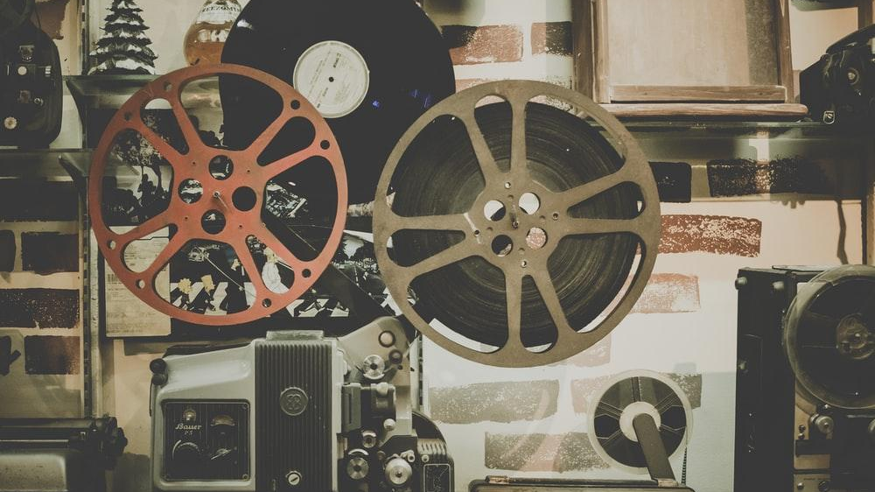
Data Science for Image Analysis
Taylor Arnold
30 March 2022

Slide 2






The Distant Viewing Lab
The Lab uses and develops computational techniques to analyze visual culture on a large scale. It develops tools, methods, and datasets that can be re-used by other researchers.
With Support From:
Lauren Tilton
Rhetoric and Communication Studies
Taylor Arnold
Linguistics and Data Science
distantviewing.org
1 – Data Science with Images

Slide 3
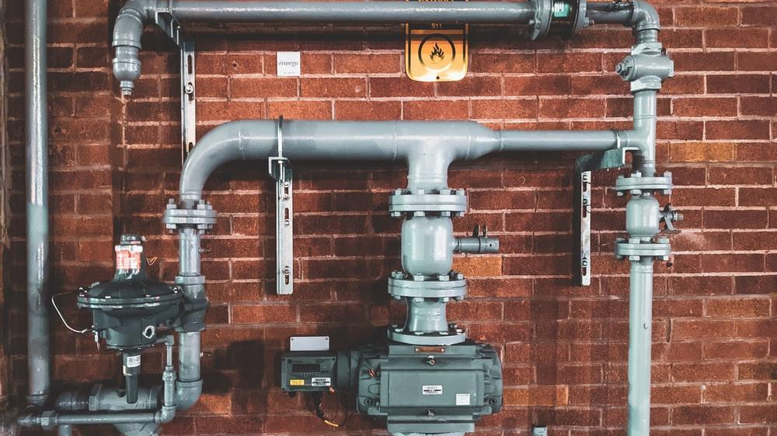
1
DATA PIPELINES

Slide 4
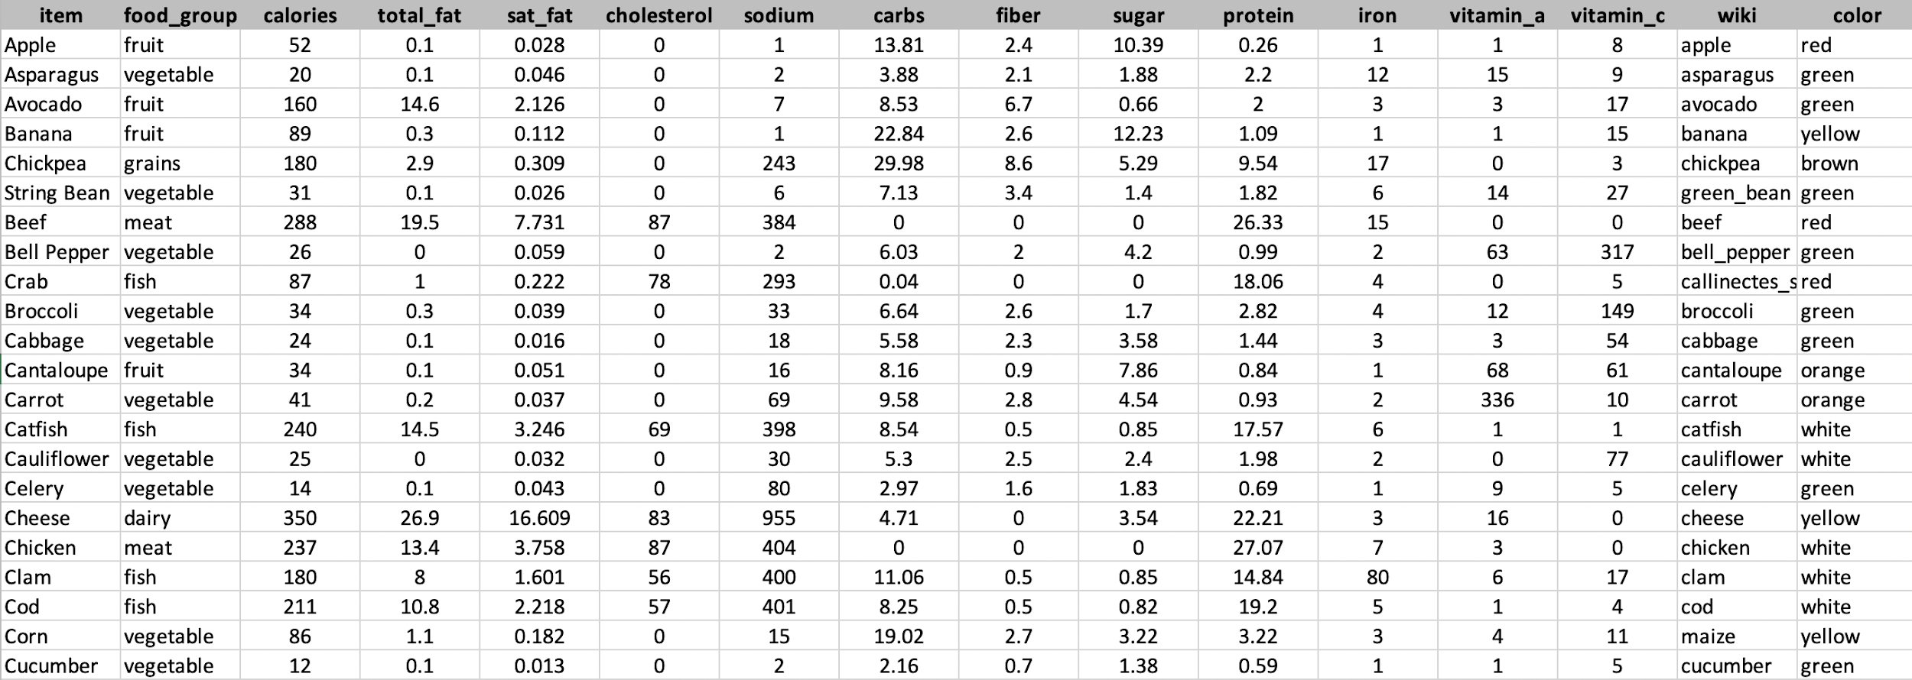

Working with Structured Data
An exploratory analysis usually begins with a table of records. The example here is already fairly clean, but you may have to do some manual fixes before it can be loaded into your database or statistical software.
2 – Data Science with Images | Pipelines

Slide 5
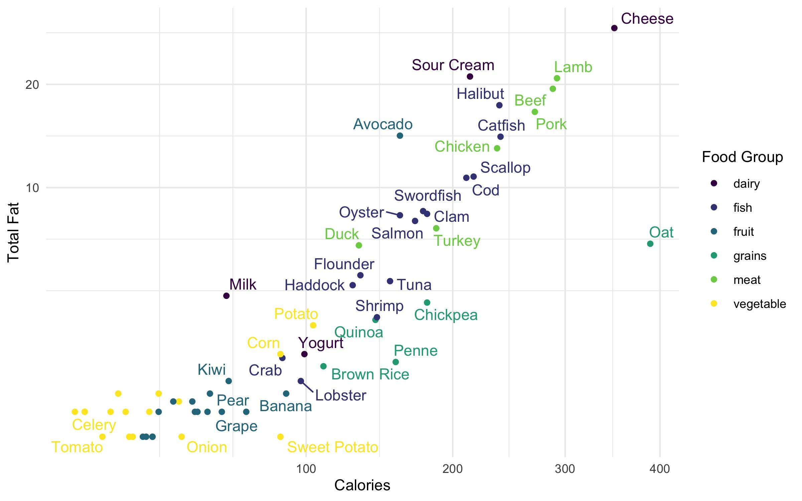
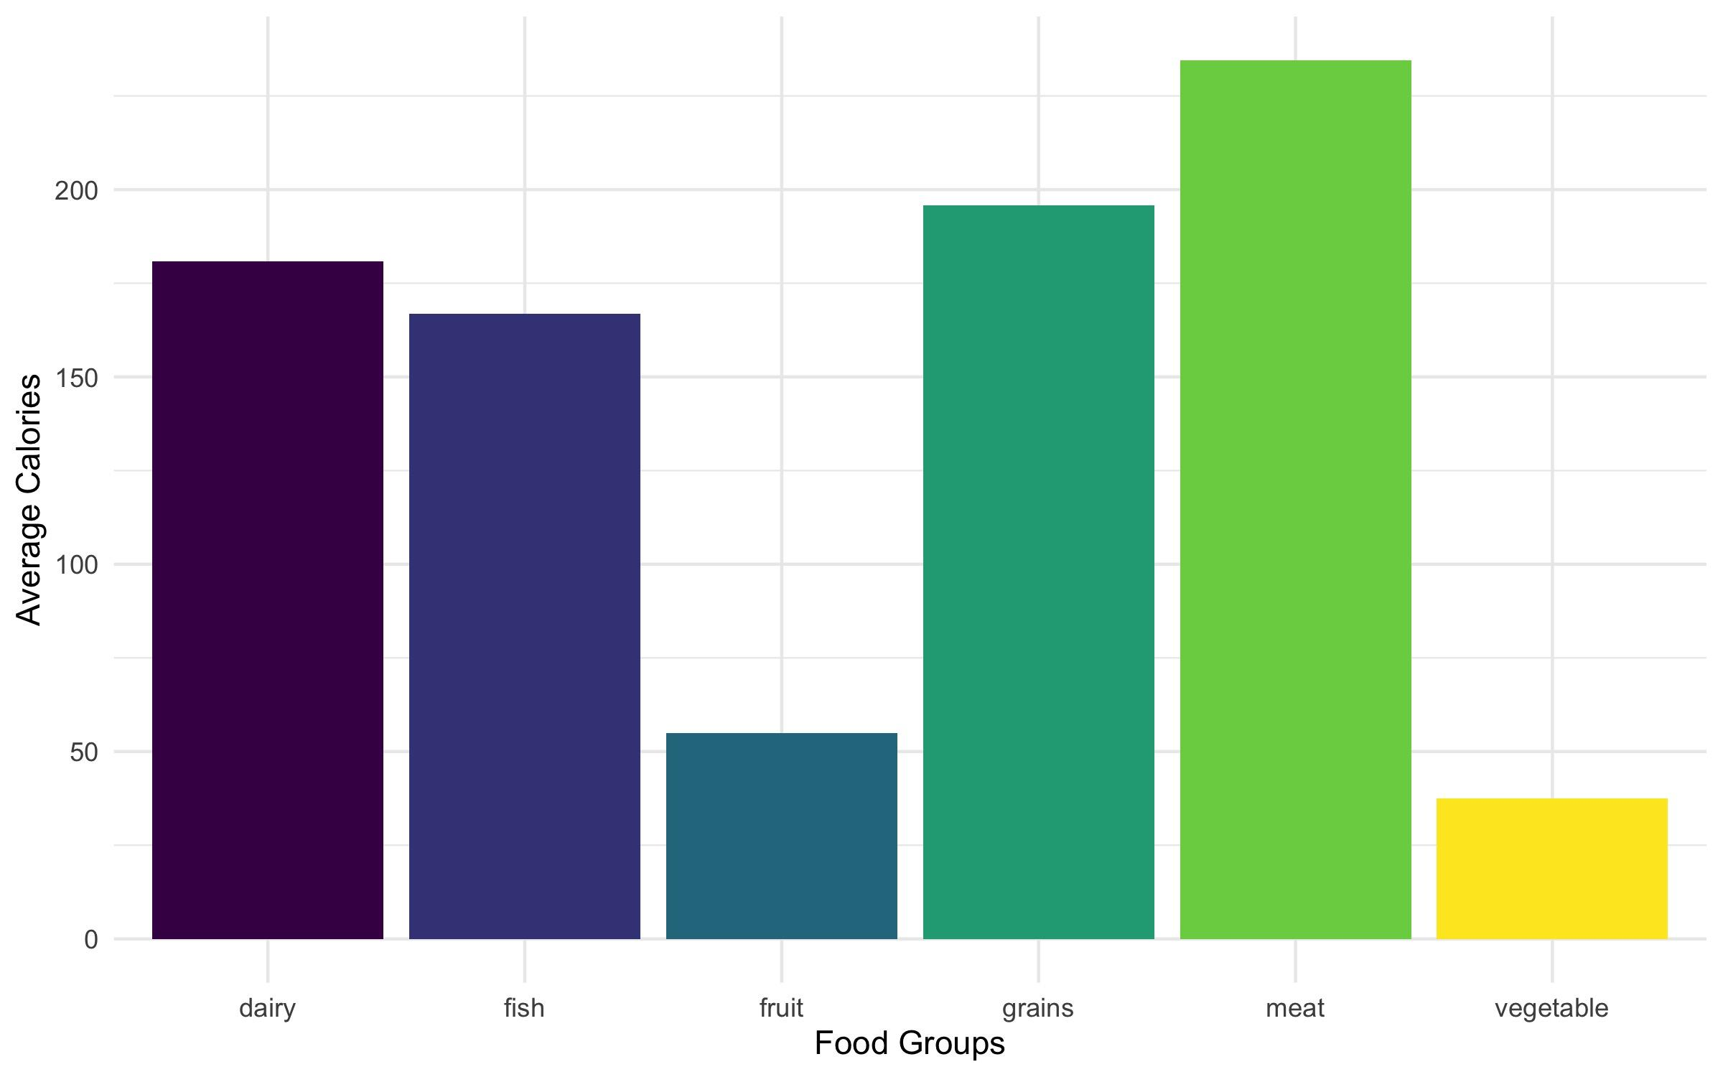
Visualising Structured Data
Once the data are organised, we can begin to explore the data. We might start with several visualisation of the main variables or transformations of the data.
3 – Data Science with Images | Pipelines

Slide 6
Modelling Structured Data
Or, we can fit a model. Here, I have run a linear regression predicting the number of calories in 100g of a food type based on its fat, sugar, and protein.
lm(formula = calories ~ total_fat + sat_fat + sugar + protein,
data = food)
Residuals:
Min 1Q Median 3Q Max
-33.841 -20.896 -12.469 4.761 235.487
Coefficients:
Estimate Std. Error t value Pr(>|t|)
(Intercept) 37.7662 11.1174 3.397 0.00126 **
total_fat 10.3866 2.2326 4.652 2.05e-05 ***
sat_fat -3.9638 4.1974 -0.944 0.34905
sugar 1.3416 1.5160 0.885 0.37996
protein 3.4488 0.7765 4.442 4.26e-05 ***
---
Signif. codes: 0 ‘***’ 0.001 ‘**’ 0.01 ‘*’ 0.05 ‘.’ 0.1 ‘ ’ 1
Residual standard error: 41.78 on 56 degrees of freedom
Multiple R-squared: 0.8068, Adjusted R-squared: 0.793
F-statistic: 58.45 on 4 and 56 DF, p-value: < 2.2e-16
4 – Data Science with Images | Pipelines

Slide 7

A Pipeline for Structured Data
Putting these pieces together, we can describe a pipeline for doing an exploratory analysis with structured data. Arrows show a logical flow of information, but of course most analyses require a lot of back and forth between each part.
Visualize
Organize
Transform
Communicate
Data
Model
Explore
Data Science Pipeline (Wickham, H. and Grolemund, G., 2017)
The pipeline indentifies the needs for different tools, highlights the assumptions of each stage of an analysis, and gives guidance on an overall approach.
5 – Data Science with Images | Pipelines

Slide 8
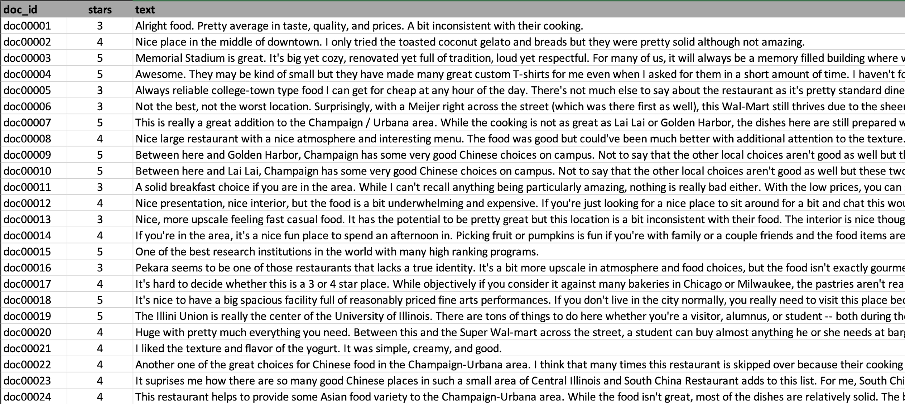
Working with Textual Data
Now, what if you were given data where one of the main colums contains unstructured text? We can organise and read into R as a table, but then what?
6 – Data Science with Images | Pipelines

Slide 9
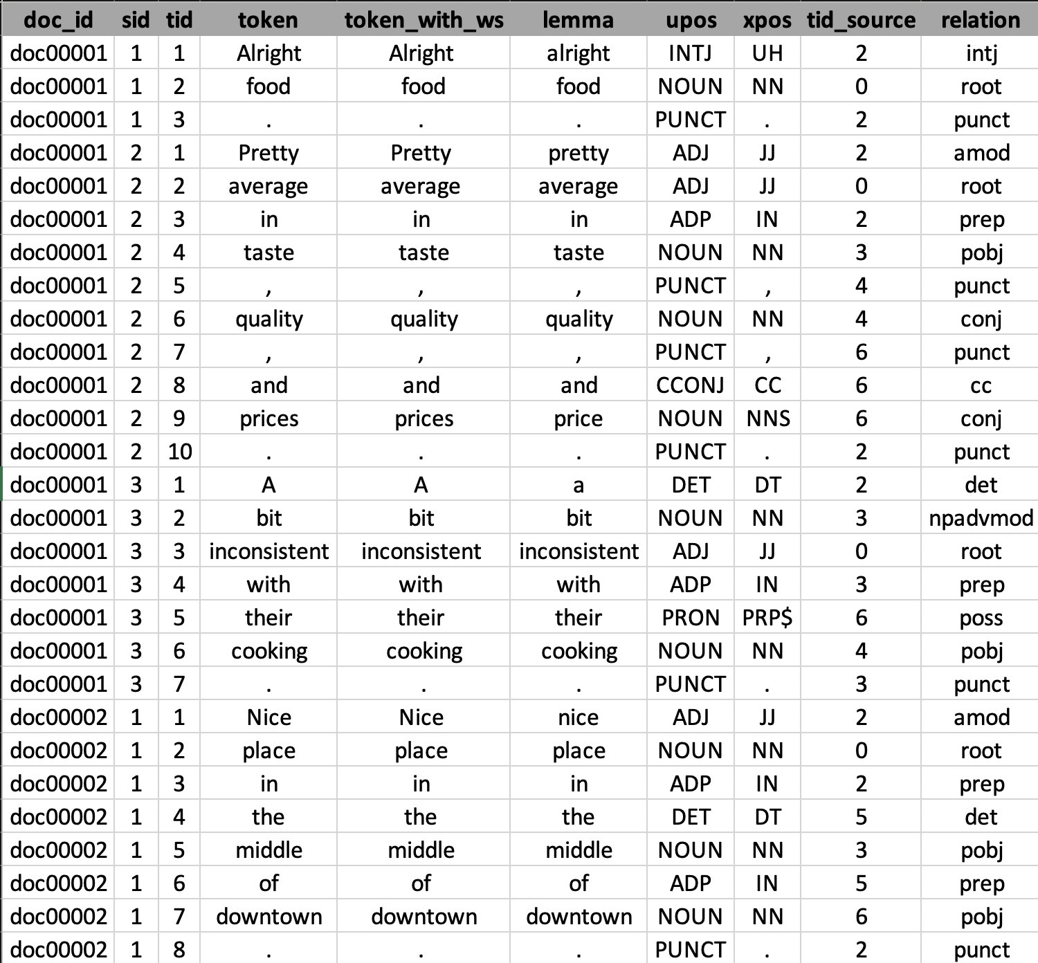
Tokenizing Textual Data
As a more usable format, we can tokenize the data by splitting the text up into individual words and punctuation marks.
If you read this table down the column, you will put back together the original text.
7 – Data Science with Images | Pipelines

Slide 10
Enriching Textual Data
Running additional models over the tokens generated an enriched form of the data; here we have added lemmas, part of speech tags, and grammatical relationships.
8 – Data Science with Images | Pipelines

Slide 11
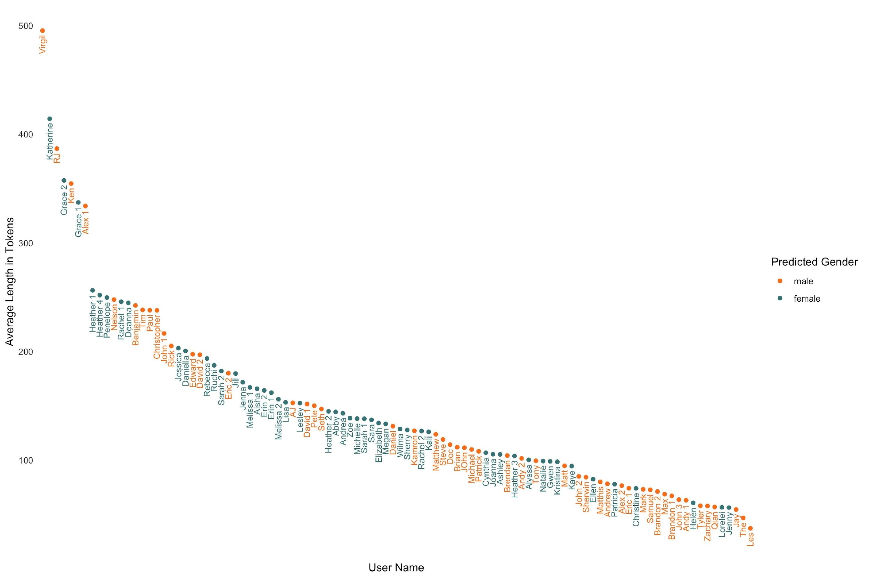
Visualising Textual Data
Loading the tokens into our software, we can use standard techniques to run all kinds of analyses and visualisations.
For example, let’s see the average length of a post for each user in the dataset by gender.
Groups of outliers with long reviews
Shortest reviews are male dominated
9 – Data Science with Images | Pipelines

Slide 12
Term Frequency Matrix
A very common approach to working with the tokens is to create a term frequency matrix, with one row per document, one column per token, and values giving the number of times each token is used in a document.
. be the and , a I to of have it for in but that they with this my on n't good do you not
doc00001 3 . . 1 2 1 . . . . . . 1 . . . 1 . . . . . . . .
doc00002 2 1 2 1 . . 1 . 1 . . . 1 1 . 1 . . . . . . . . 1
doc00003 4 4 1 . 3 1 . . 2 . 2 1 . . . 1 . . . . . . . . .
doc00004 4 2 4 2 1 2 3 . 3 3 2 2 1 2 1 3 . . . 1 1 . . . .
doc00005 3 4 4 1 . . 1 1 1 . 1 1 . . 1 . 1 . . . . . . . 1
doc00006 9 10 12 3 13 4 1 6 7 . 1 1 1 2 2 1 2 2 . 1 2 4 2 3 3
doc00007 13 19 20 9 9 4 2 5 2 . 4 3 4 . 3 1 3 2 . . 1 3 . . 1
doc00008 12 8 9 8 6 8 . 1 6 . . . 1 5 . . 6 . . . 1 5 . 1 1
doc00009 4 3 4 2 2 . . 5 1 1 . 1 . 1 3 . . . . 1 2 3 . 1 1
doc00010 5 3 4 2 3 . . 6 1 1 1 1 . 1 4 . . 1 . 1 4 3 2 2 2
doc00011 3 3 3 . 2 1 1 . . . . . 2 . . . 1 . . 1 1 . . 3 .
doc00012 3 5 2 2 2 4 . 2 . . 1 2 . 2 . . . 1 . . . 1 . 3 .
doc00013 3 3 2 . 1 1 . 1 . 1 1 . . 1 . . 1 1 . . . . . . .
doc00014 2 5 2 1 2 2 . 1 . . 1 . 2 . . . 1 . . . . . . 2 .
doc00015 1 . 2 . . . . . 1 . . . 1 . . . 1 . . . . 1 . . .
doc00016 4 8 4 1 3 4 1 3 2 . 2 2 3 2 2 1 1 . . . 3 1 . 1 1
doc00017 3 7 1 1 3 2 1 2 1 . 3 . 2 2 2 . . 1 . . 3 . . 1 .
doc00018 2 2 1 . 1 1 . 3 1 1 1 . 2 . . . . 1 . . 1 . 1 4 1
doc00019 7 6 11 5 13 4 . 10 7 2 . 4 2 . . . . 1 . 1 2 . 2 3 .
doc00020 2 . 2 1 1 1 . . . . . . . . . . 1 1 . . . . . 1 .
10 – Data Science with Images | Pipelines

Slide 13
Modelling Textual Data
With the term-frequency matrix, we can build a variety of predictive and unsupervised models. Here’s another linear regression model, this time predicting stars.
Call:
lm(formula = stars ~ love + bad + exclaim + good, data = df)
Residuals:
Min 1Q Median 3Q Max
-5.0429 -0.6224 0.3176 0.9956 2.6192
Coefficients:
Estimate Std. Error t value Pr(>|t|)
(Intercept) 3.48058 0.03072 113.308 < 2e-16 ***
love 0.31440 0.04412 7.126 1.31e-12 ***
bad -0.50115 0.04843 -10.347 < 2e-16 ***
exclaim 0.13096 0.01488 8.802 < 2e-16 ***
good 0.07089 0.01967 3.603 0.000319 ***
---
Signif. codes: 0 ‘***’ 0.001 ‘**’ 0.01 ‘*’ 0.05 ‘.’ 0.1 ‘ ’ 1
Residual standard error: 1.199 on 2795 degrees of freedom
Multiple R-squared: 0.09271, Adjusted R-squared: 0.09141
F-statistic: 71.4 on 4 and 2795 DF, p-value: < 2.2e-16
11 – Data Science with Images | Pipelines

Slide 14
Towards a Pipeline for Textual Data
There has been a lot of research in the past decade describing and building tools for the process of doing data science with text. Here are a few examples.
T. Arnold and L. Tilton. Humanities Data in R: Exploring Networks, Geospatial Data, Images, and Text. (Springer, 2015).
T. Arnold. "A Tidy Data Model for Natural Language Processing Using cleanNLP." The R Journal, 9.2 (2017): 248-267.
J. Silge and D. Robinson. Text Mining with R. (O’Reilly, 2017)
Mullen, L., K. Benoit, O. Keyes, O., D. Selivanov, and J. Arnold, 2018. “Fast, consistent tokenization of natural language text.” Journal of Open Source Software, 3(23), p.655.
Benoit, K., K. Watanabe, H. Wang, P. Nulty, A. Obeng, S. Müller, and A. Matsuo. (2018) "quanteda: An R package for the quantitative analysis of textual data." Journal of Open Source Software. 3(30), 774.
T. Arnold, N. Ballier, P. Lissón and L. Tilton. "Beyond Lexical Frequencies: Using R for Text Analysis in the Digital Humanities." Language Resources and Evaluation (2019).
12 – Data Science with Images | Pipelines

Slide 15

A Pipeline for Textual Data
Our data analysis pipeline needs some modification for working with text. With widely-available libraries, the analysis of textual data can by integrated with existing software.
Visualize
Tokenize
&
Enrich
Join
Transform
Communicate
Model
Textual Data
Explore
Metadata
Textual data needs to be tokenised and possibly enriched with linguistic data. It can then fit into existing tools, though specific models and approaches are often useful.
13 – Data Science with Images | Pipelines

Slide 16
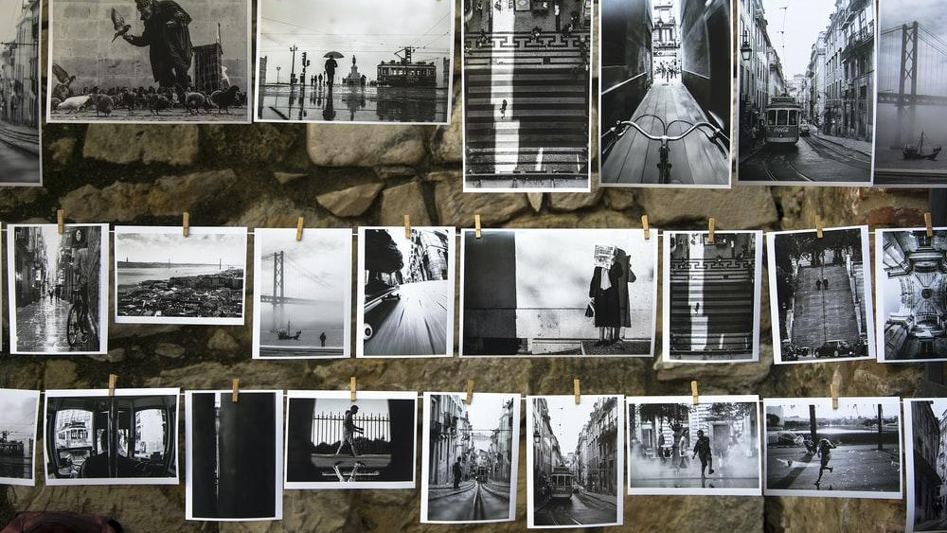
2
IMAGE DATA

Slide 17
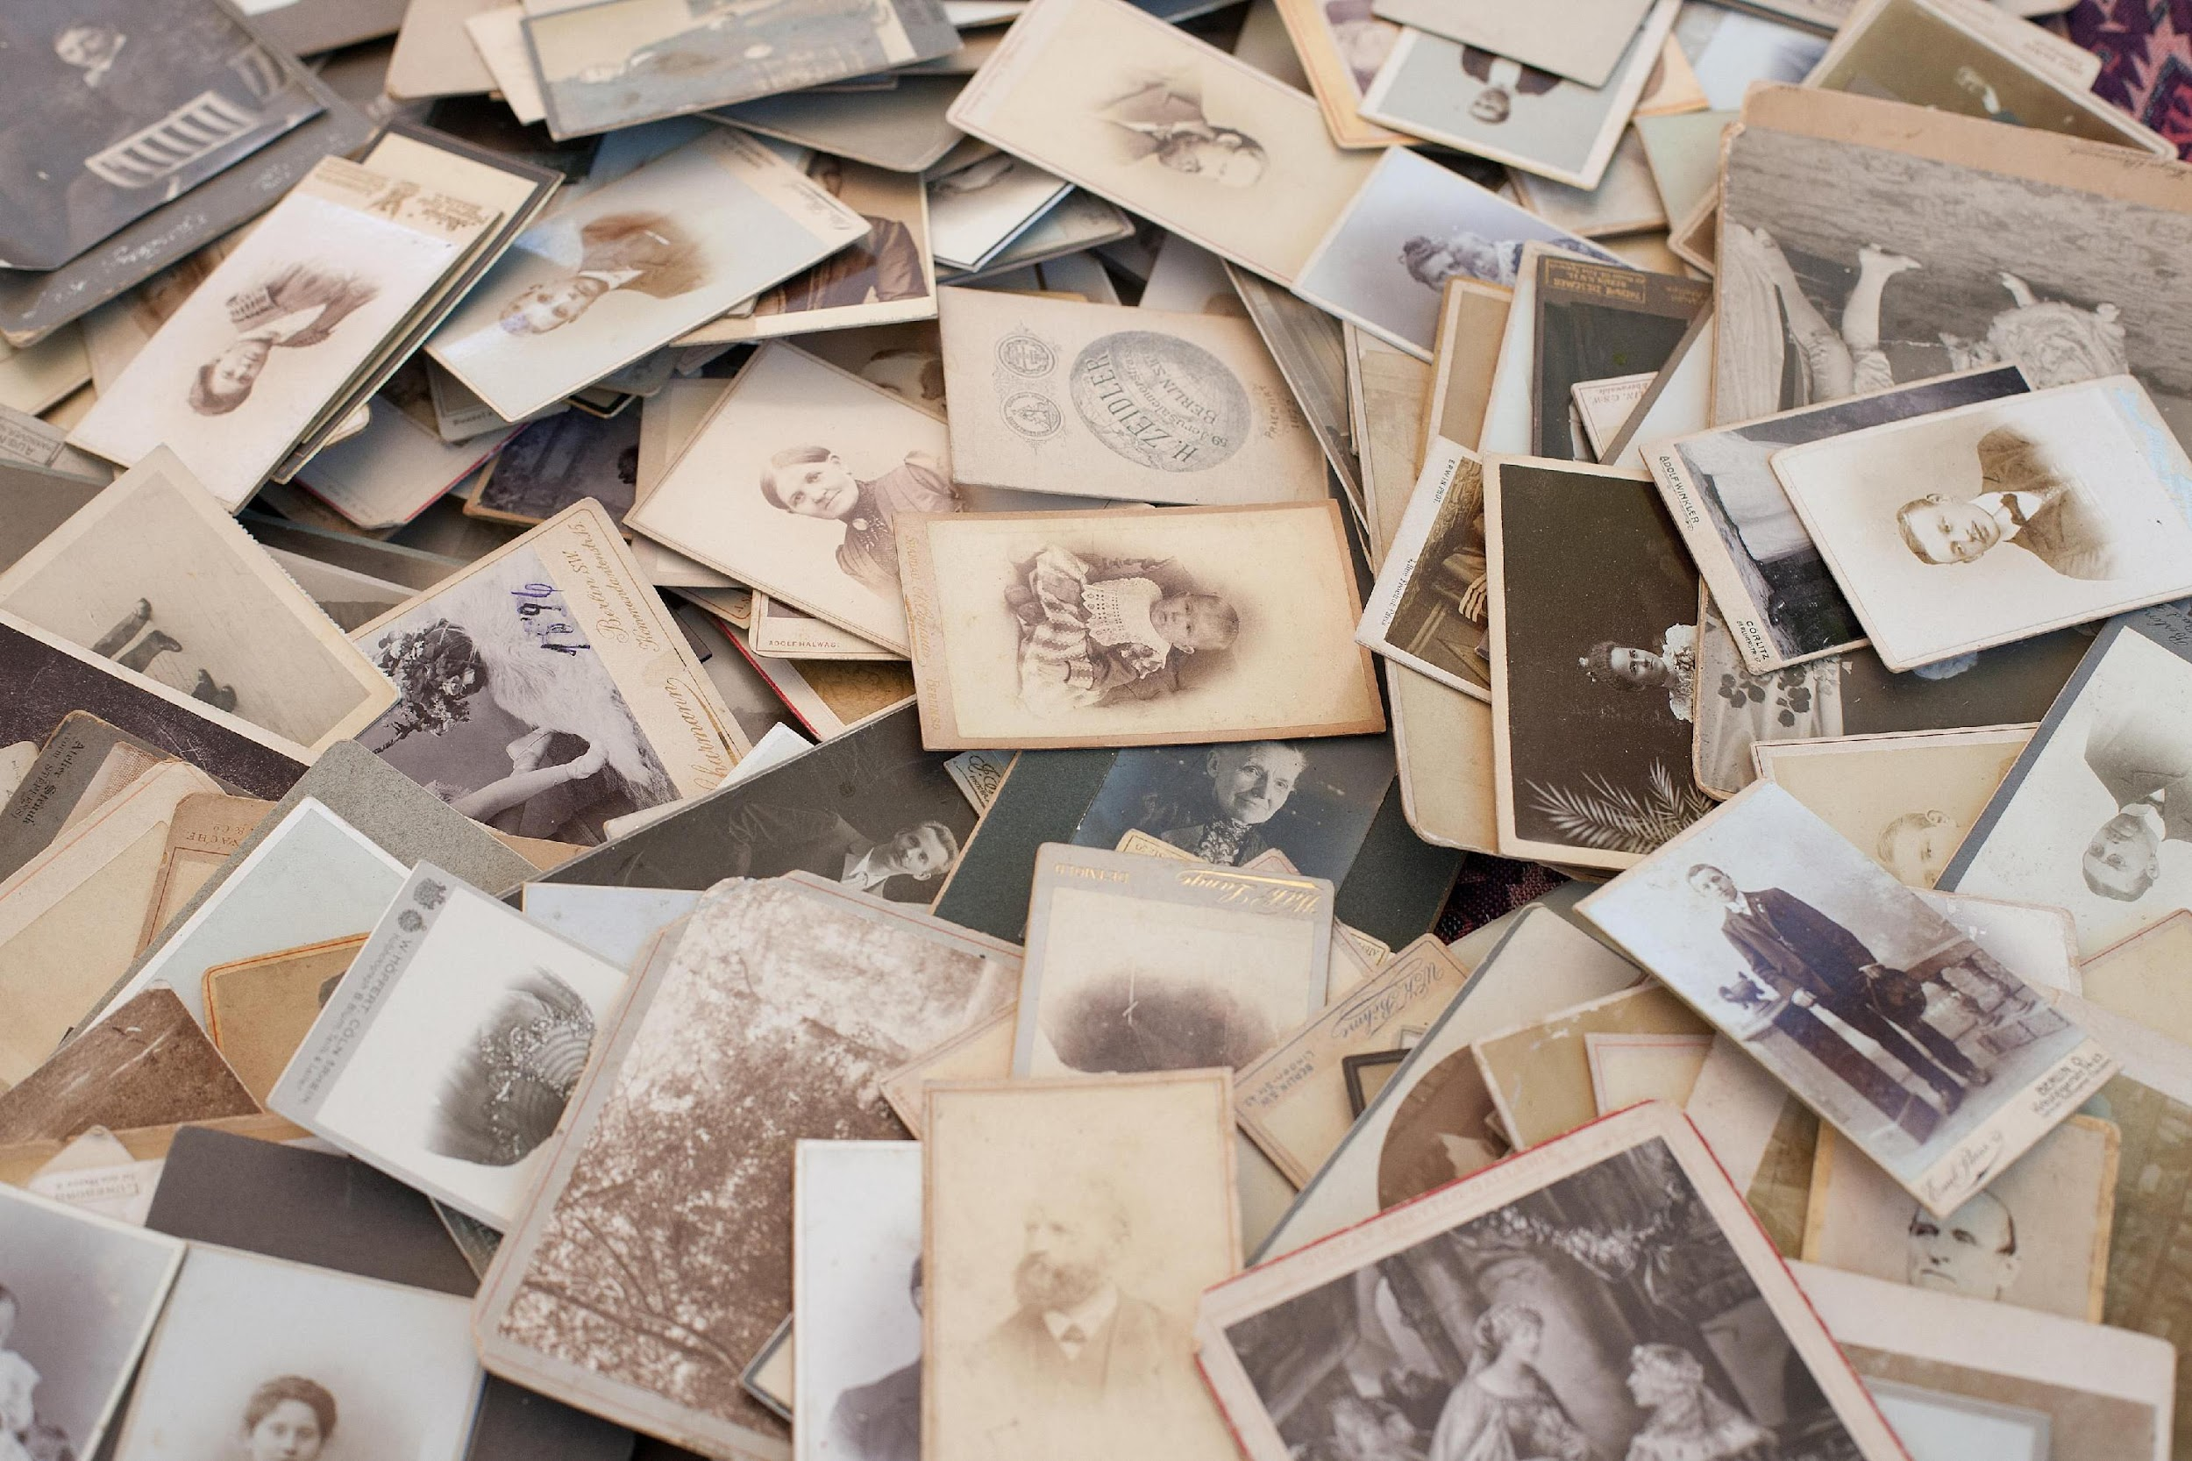
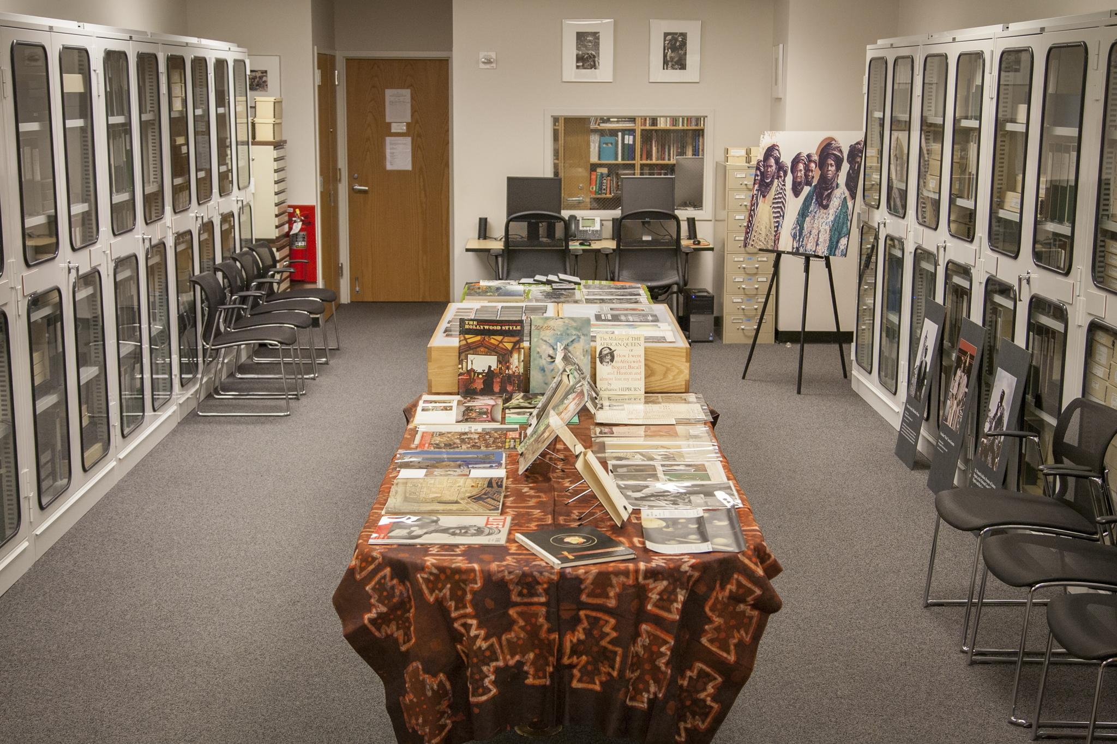
Working with Image Data
Now, what if our dataset contains image data. For example, this could be a table of metadata with an associated URL pointing to an image. How does this change our pipeline?
14 – Data Science with Images | Image Data

Slide 18
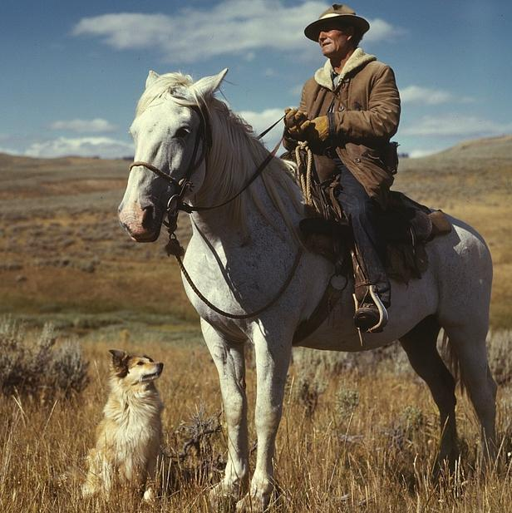
Working with Image Data
To get to the bottom of this, let’s consider a single image and how we might be able to turn it into structured data that we can visualise, transform, and model.
15 – Data Science with Images | Image Data

Slide 19
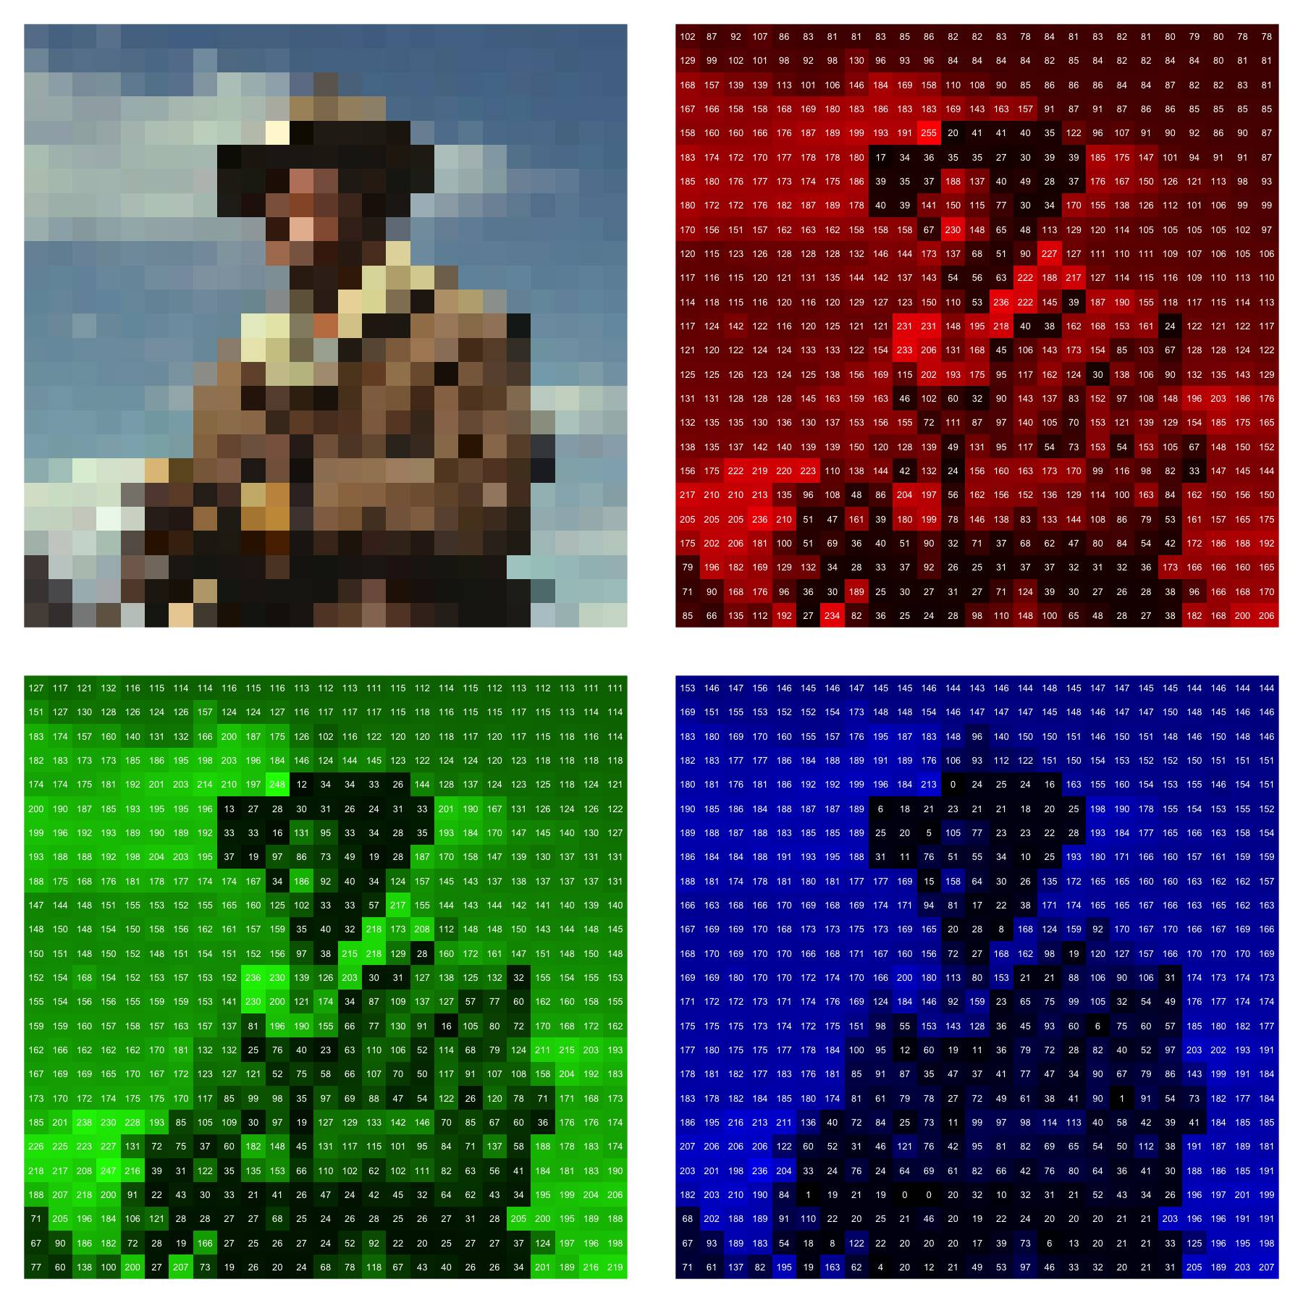
RGB Pixel Intensities
The smallest addressable unit of a digital image is called a pixel. For a color image, each pixel is typically displayed, measured and stored as a number describing the red, green, and blue intensity of light for a given point on the image.
16 – Data Science with Images | Image Data

Slide 20
RGB Pixel Intensities
We can read these pixel intensities into a programming software and represent an image as a three-dimensional array.
To the left are the intensities from a corner of our reference image.
RED
[,1] [,2] [,3] [,4]
[1,] 0.9568627 0.9490196 0.9176471 0.9294118
[2,] 0.3411765 0.3058824 0.2901961 0.2588235
[3,] 0.3294118 0.3019608 0.2901961 0.2941176
[4,] 0.3450980 0.2823529 0.2784314 0.2627451
GREEN
[,1] [,2] [,3] [,4]
[1,] 0.9921569 1.0000000 1.0000000 1.0000000
[2,] 0.3803922 0.3686275 0.3764706 0.3529412
[3,] 0.3764706 0.3725490 0.3843137 0.4000000
[4,] 0.4039216 0.3647059 0.3803922 0.3725490
BLUE
[,1] [,2] [,3] [,4]
[1,] 1.0000000 1.0000000 1.0000000 1.0000000
[2,] 0.4156863 0.4313725 0.4666667 0.4549020
[3,] 0.4392157 0.4588235 0.4941176 0.5176471
[4,] 0.4862745 0.4705882 0.5098039 0.5254902
17 – Data Science with Images | Image Data

Slide 21
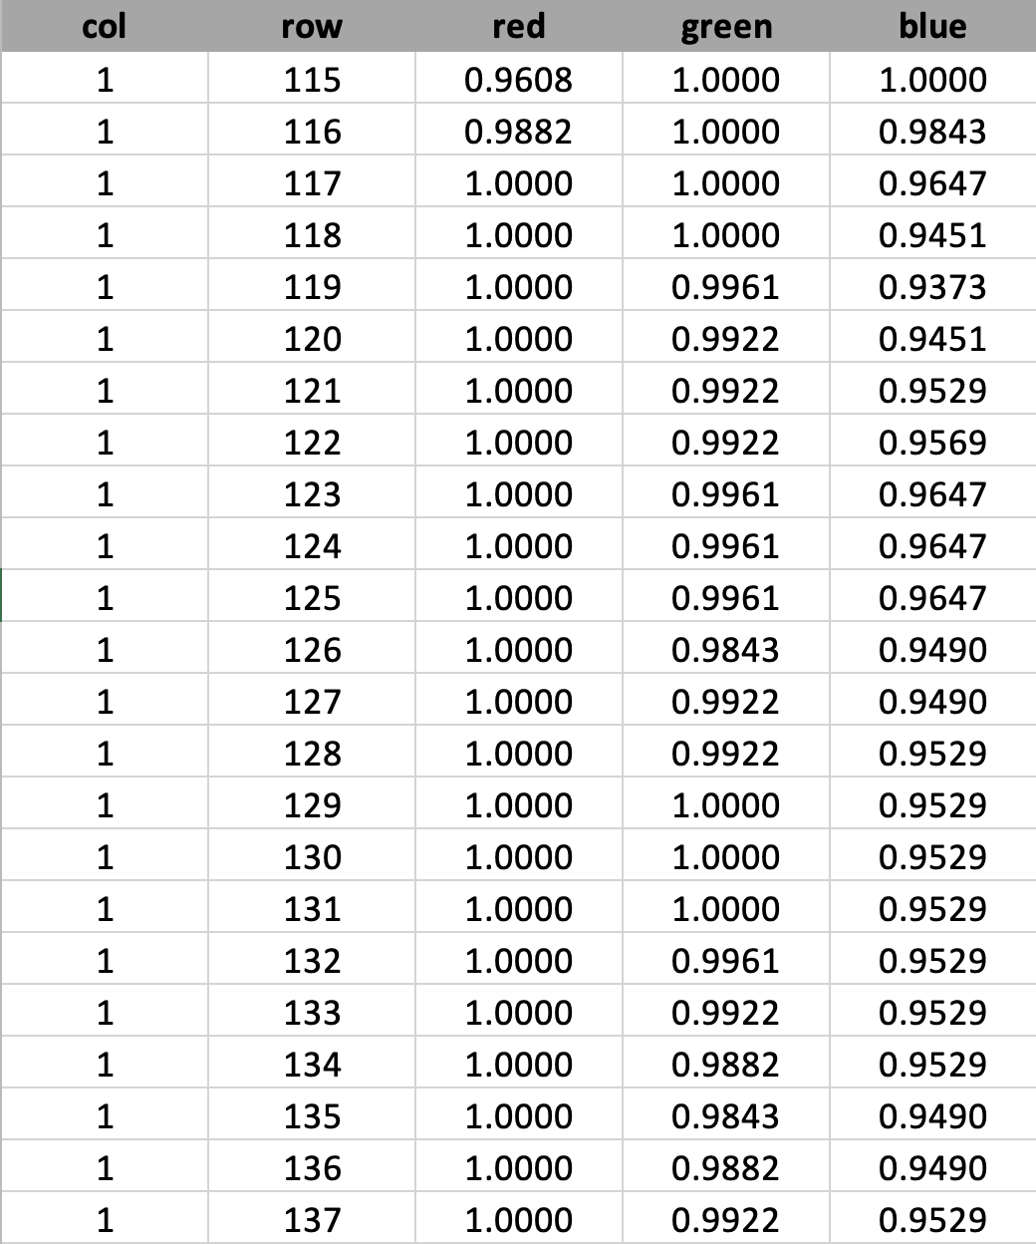
RGB Pixel Intensities => Data
With a little code we can unravel these intensities and store them as a pixel-level dataset. This has one row for each pixel, the coordinates, and intensities for the three color channels.
At first, this seems very similar to our approach with textual data. But there is a fundamental problem.
18 – Data Science with Images | Image Data

Slide 22
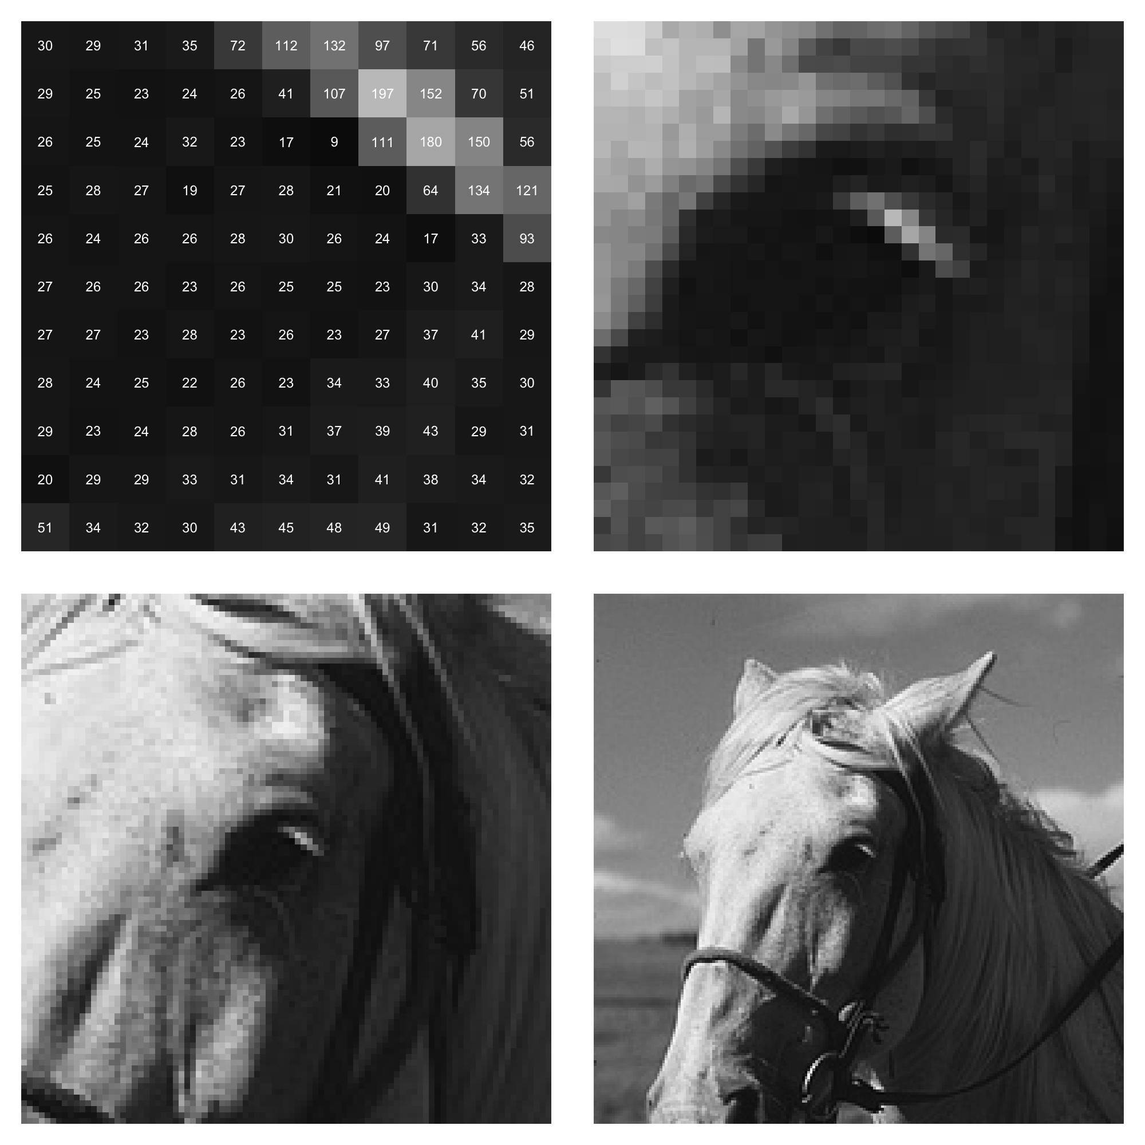
Pixels, cont.
For simplicity, consider a greyscale image. On the right are two different zoom levels of an image.
Can you tell what is depicted in the image?
19 – Data Science with Images | Image Data

Slide 23
Pixels, cont.
Adding two more zoom levels, we can now see that this an image centered on the horse from the reference image.
The meaning of the pixels only begins to become understandable when we see all of the pixels relative to one another.
20 – Data Science with Images | Image Data

Slide 24
The Difficulties of Images
Organising a dataset at a pixel-level does provide the same affordances that we have from organising text into characters and words.
Letters and words are socially mediated forms specifically designed to transfer information. Pixels are measurements of a light source and only convey meaning when put together to mimic the process of observing the light source ourselves.
Because of the lack of a formal language system in an image, we cannot unambigiously group and describe collections of pixels. The best we can do is apply computer vision algorithms to contruct annotations describing the image
21 – Data Science with Images | Image Data

Slide 25
Computer Vision Annotations
What kinds of annotations could be extract from an image? Some relatively simple ones might be the brightness of the image, the location of faces in the image, or the objects detected in the image.
Brightness: 37
Face: [10, 25, 200, 215]
Objects: {"man", "horse", "dog"}
22 – Data Science with Images | Image Data

Slide 26
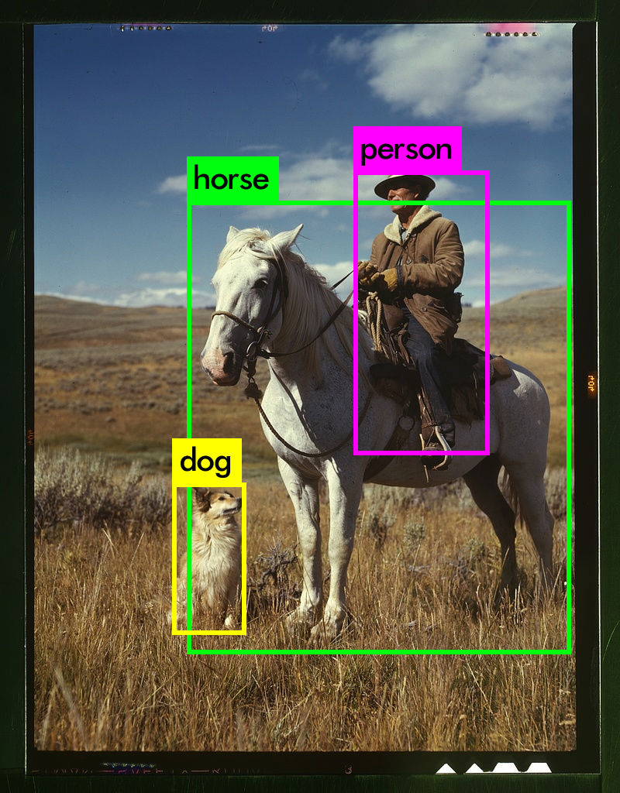
Bounding Boxes
Even once we know the kind of information we want to capture, building or finding an algorithm to apply the technique may be difficult.
Also, there are different types of ways to describe similar information. In lieu of a list of objects, we could instead produce bounding boxes.
23 – Data Science with Images | Image Data

Slide 27
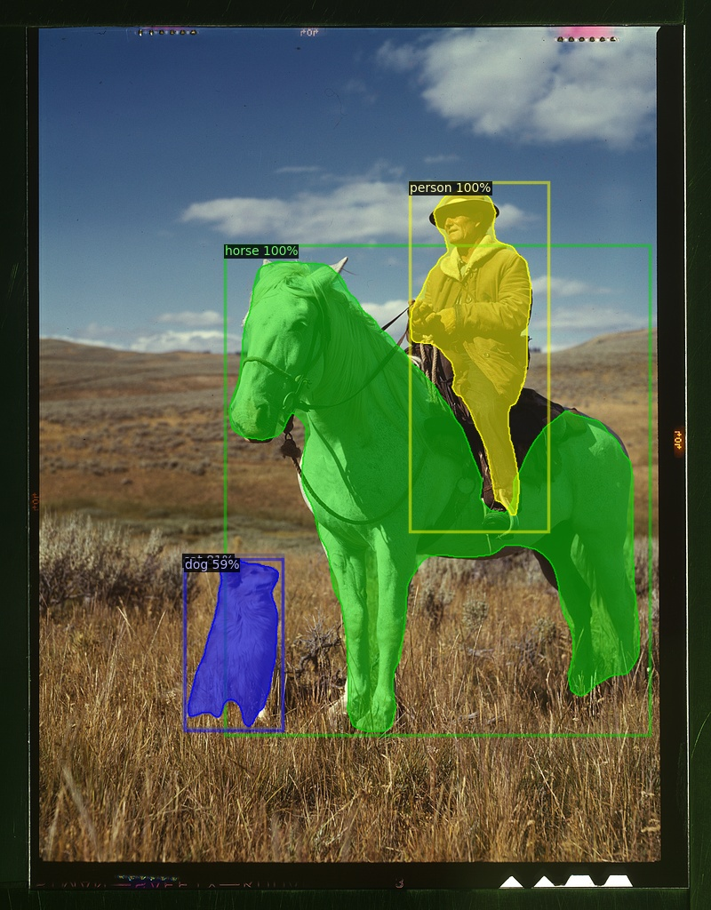
Object Regions
Or, we could identify the individual regions associated with each object.
24 – Data Science with Images | Image Data

Slide 28
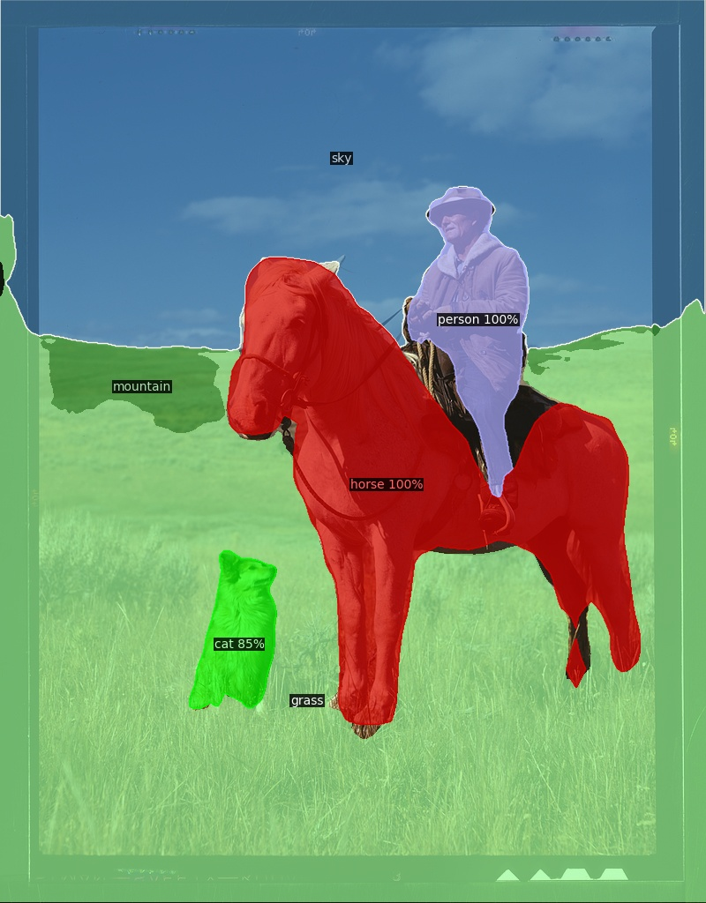
Object and ‘Stuff’ Regions
Or even include not just the objects, but entire regions such as the sky and grass.
25 – Data Science with Images | Image Data

Slide 29
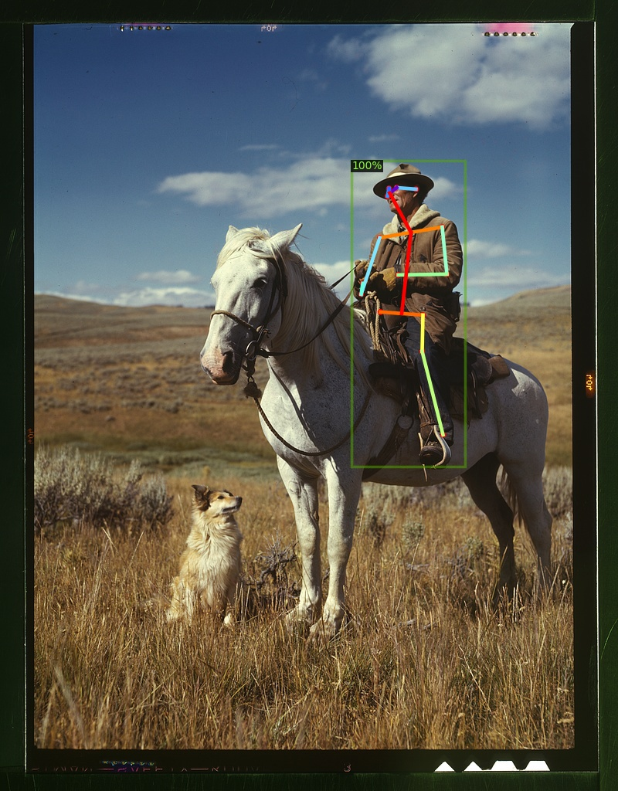
Pose Detection
Don’t think that object detection is the only the thing we might be interested in finding. We might instead by interested in identifying the poses of people in images.
26 – Data Science with Images | Image Data

Slide 30
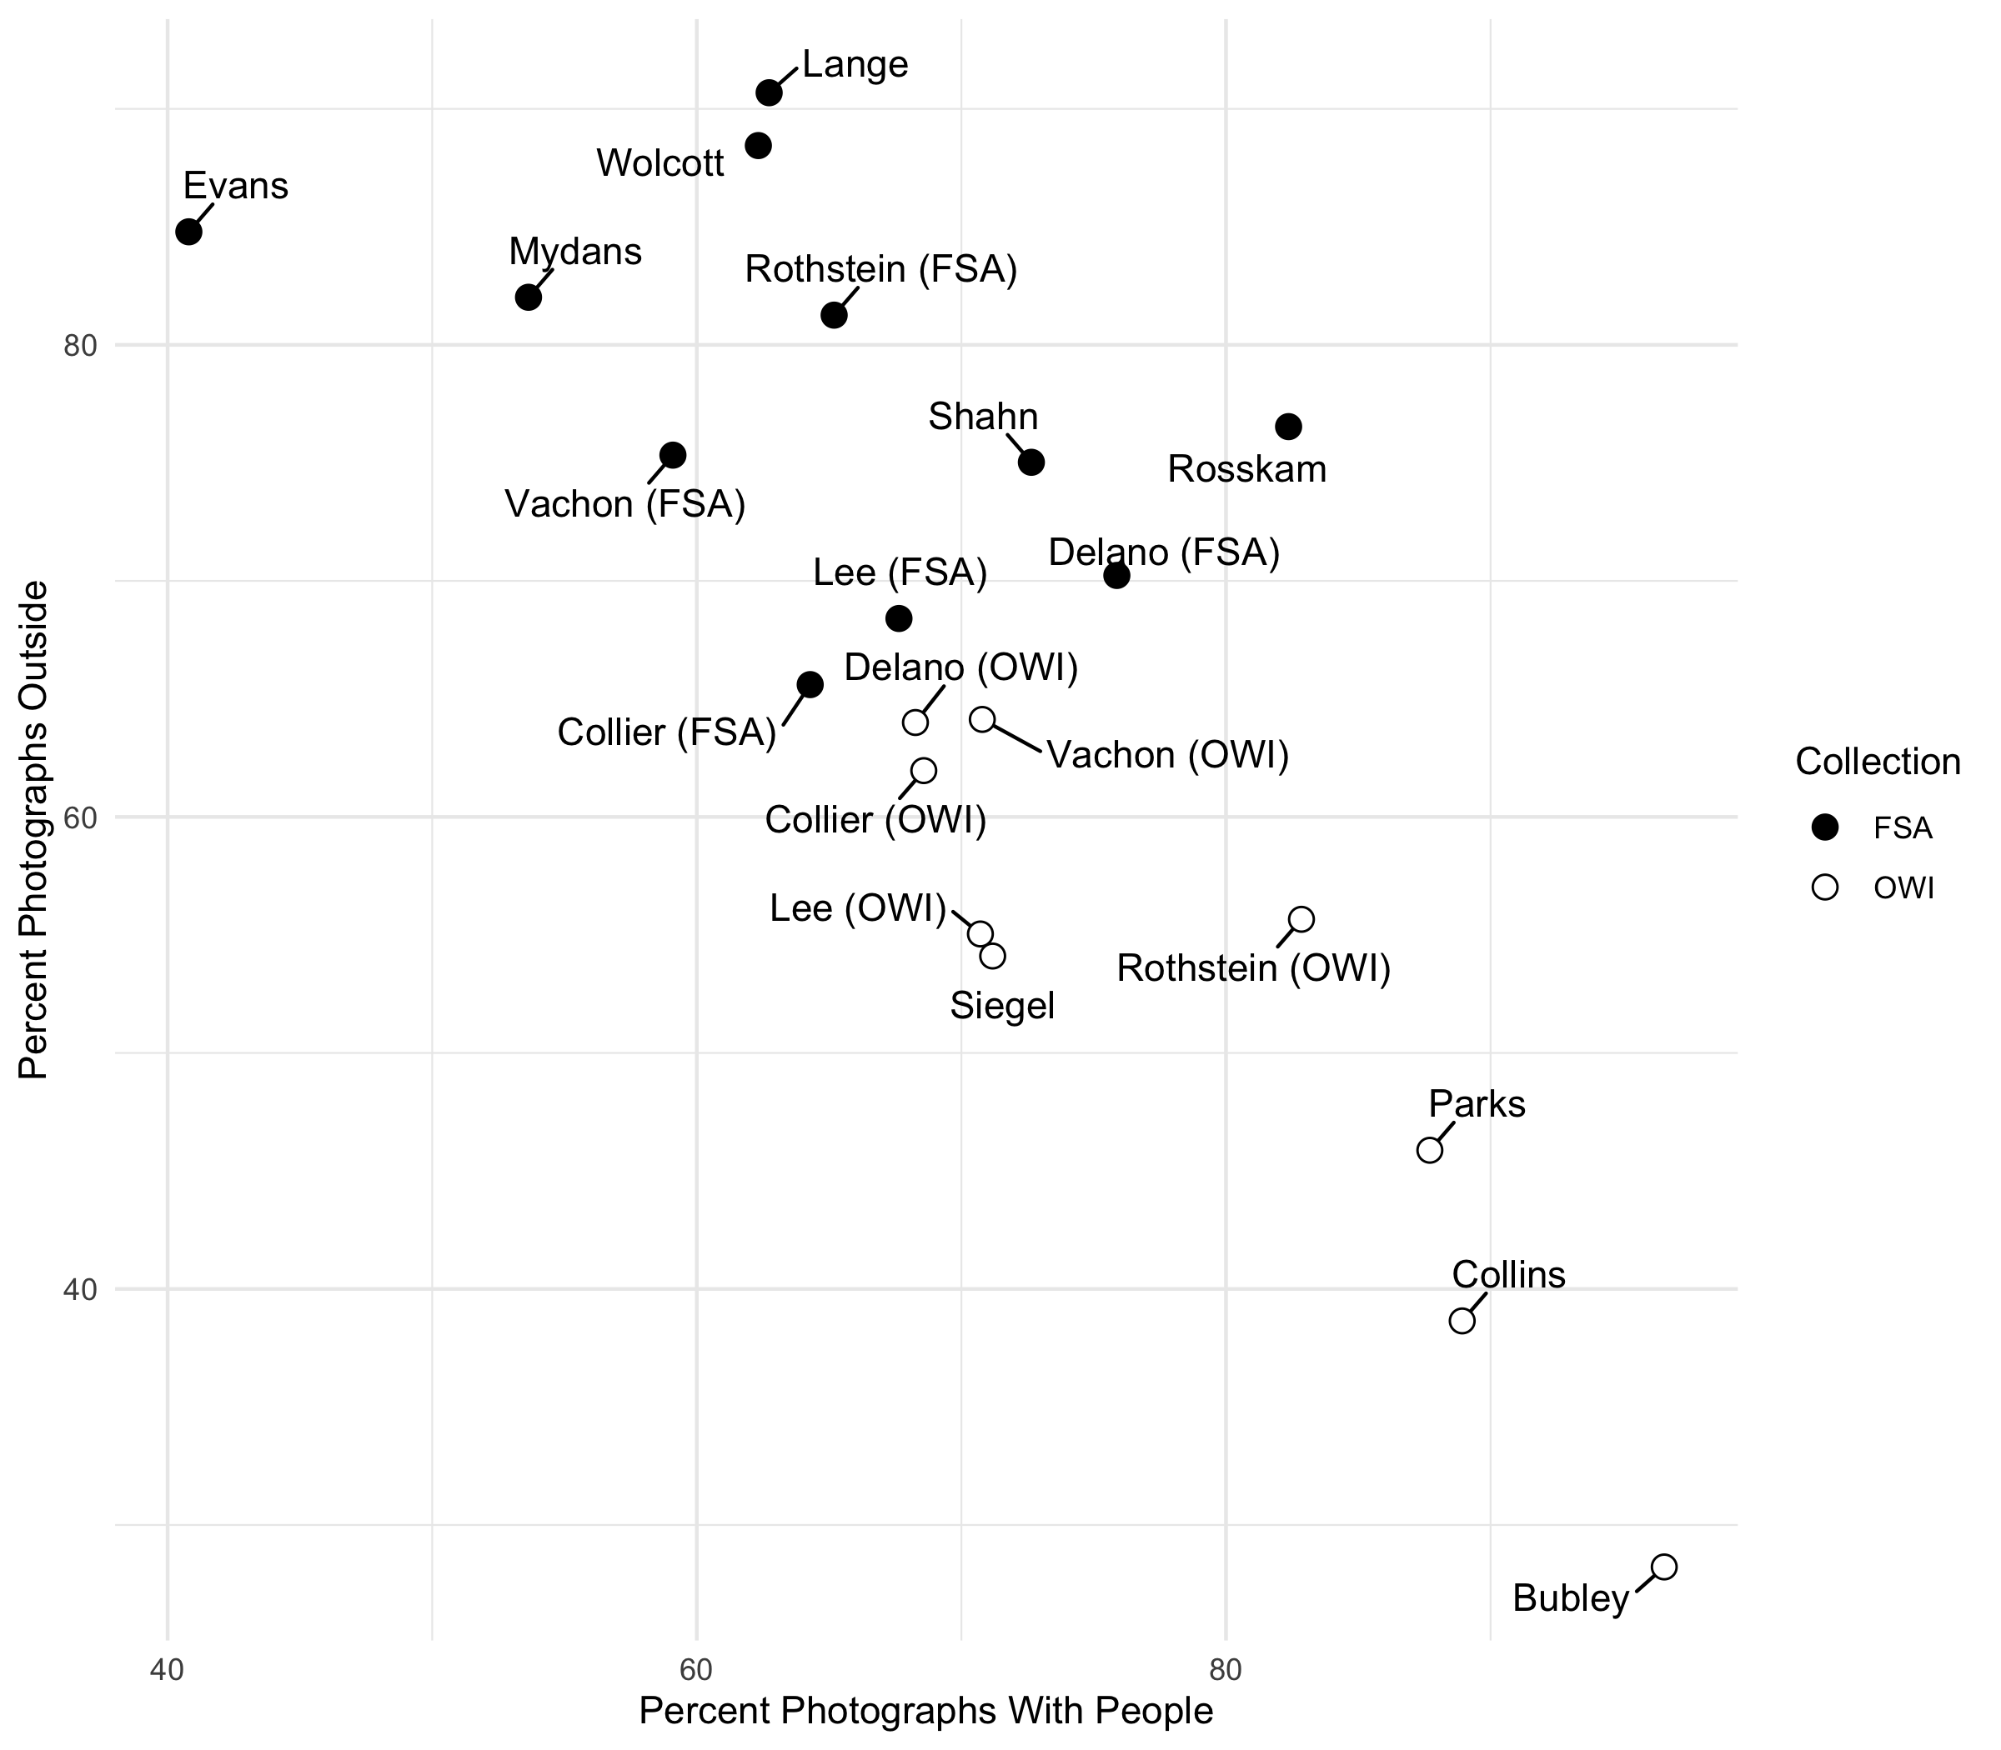
Exploratory Analysis of Images Using Computer Vision
Once we have structured annotations formated as a dataset, we can once again pick up where our other analyses left off. We can visualise, transform, model, and communicate based on the constructed annotations.
On the right are descriptions of the images taken as part of the FSA-OWI photographic collection showing the different subject matters captured by each of the main staff photographers.
27 – Data Science with Images | Image Data

Slide 31


A Pipeline for Visual Data
Putting this all back together, we see that we now have new pipeline for working with visual data. It is similar, but not the same, to the pipeline for working with textual data. This is what we refer to in our work as Distant Viewing.
Visualize
Annotate
Organize
Transform
Communicate
Model
Visual Data
Explore
Metadata
Distant Viewing (T. Arnold and L. Tilton, 2019)
The main take-away is that visual data needs to be annotated using computer vision algorithms before we can use it and that these algorithms will never fully capture the meaning of the original image.
28 – Data Science with Images | Image Data

Slide 32
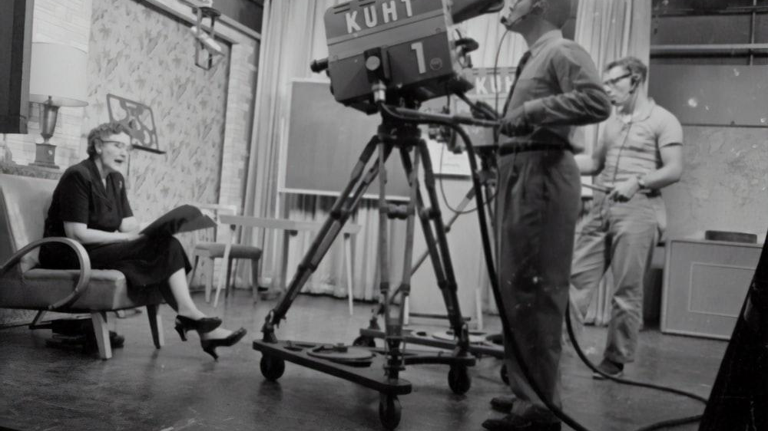
3
CASE STUDY:
Network-Era Sitcoms

Slide 33
Network-Era Sitcoms
The Network-Era of broadcast television refers to the period from the late 1950s through to the mid-1980s. This ranges from the moment that the majority of households owned a television to the rise of cable.
Research on the shows of this era are usually focused on archival and reception evidence. With limited options, the idea is that the big three networks were producing bland content aimed to attract a wide audience.
Our interest was to see if we could study shows from the era using a data science approach in order see if there are visual themes and patterns. The formulaic nature of the shows, rather than being boring, controlled from a lot of unknowns and allowed us to study a relatively strong signal.
29 – Data Science with Images | Case Study

Slide 34
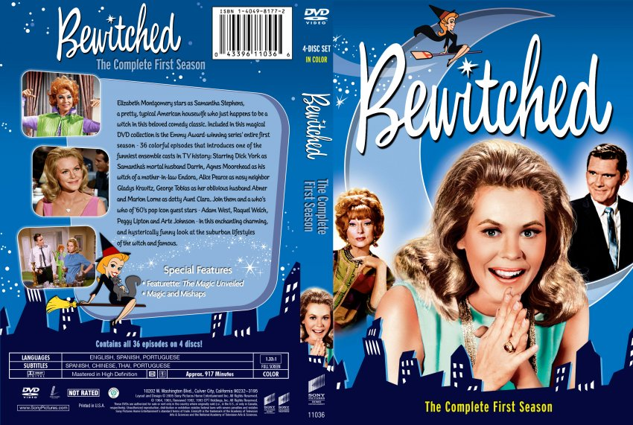
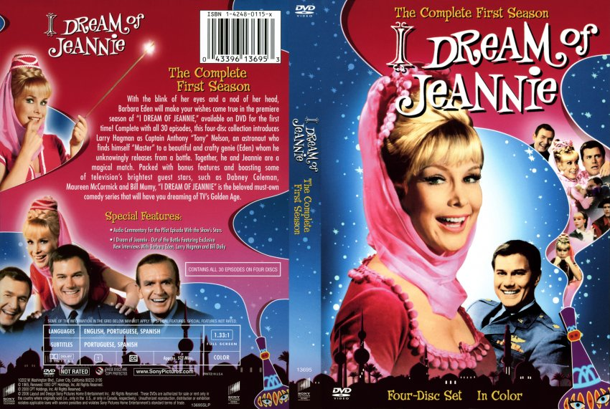
Bewitched and I Dream of Jeannie
Our study will specifically focus on two very popular television shows from the 1960s and 1970s. They are often compared to one another, making it a good choice for a controlled study.
1964–1972
1965–1970
30 – Data Science with Images | Case Study

Slide 35
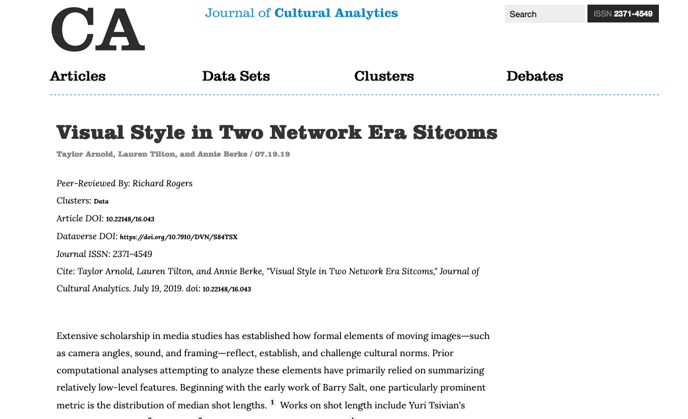
Cultural Analytics
This work, jointing done with Lauren Tilton and Annie Berke, was published as part of the Journal of Cultural Analytics.
31 – Data Science with Images | Case Study

Slide 36
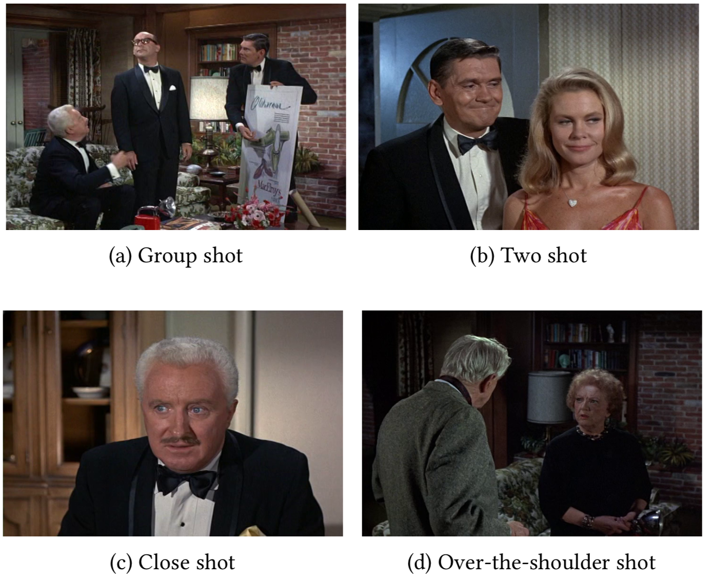
Annotating the Data
We applied computer vision algorithms to every frame in every episode of the two series. We tagged detected people, detected faces, identified faces, and identified shot breaks.
Each shot was described as being one of the four shot types on the right-side panel.
32 – Data Science with Images | Case Study

Slide 37
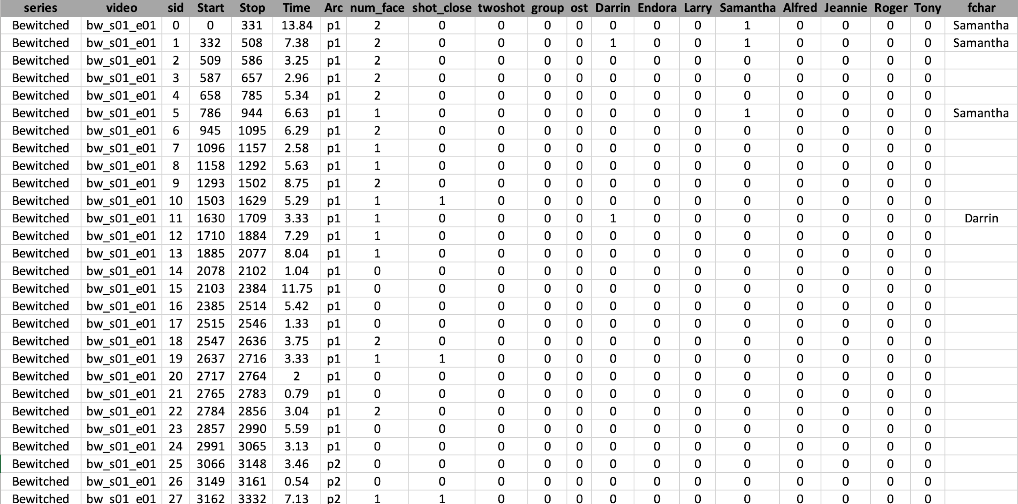
Annotating the Data
33 – Data Science with Images | Case Study

Slide 38
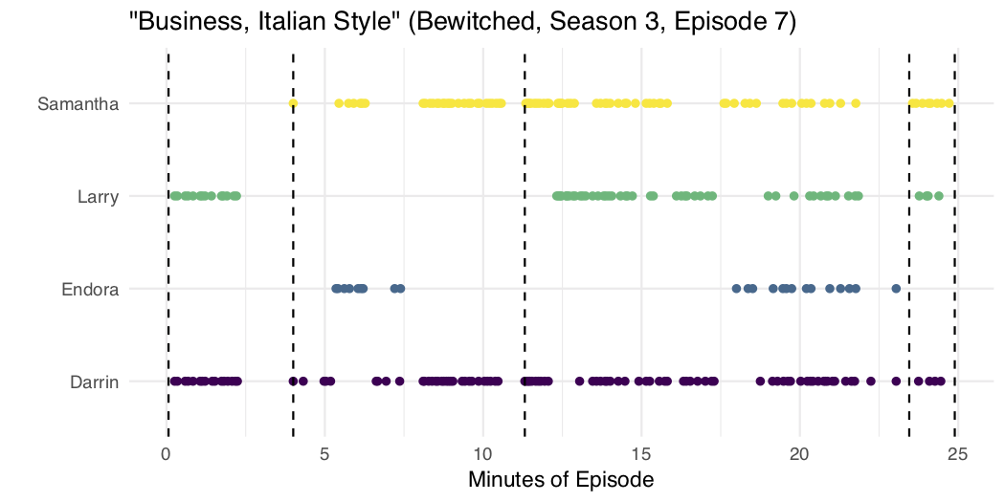
Some Exploratory Analysis
Taking just one episode and the detected faces in each shot, notice how much information is gained and lost from our annotation process.
34 – Data Science with Images | Case Study

Slide 39
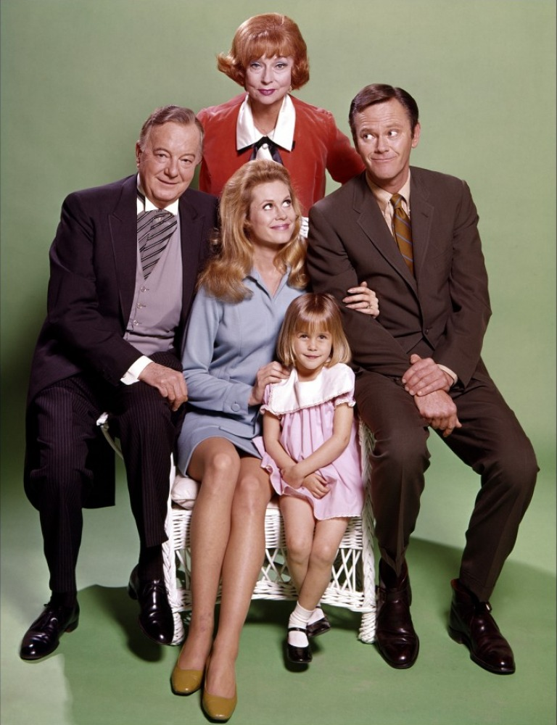
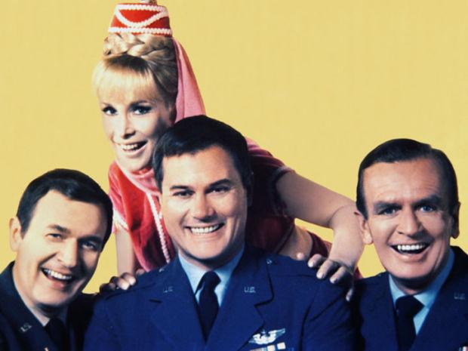
RQ1: How Does Visual Style Signal Character Centrality?
As a first research question, let’s see how visual style is used to show character centrality.
35 – Data Science with Images | Case Study

Slide 40
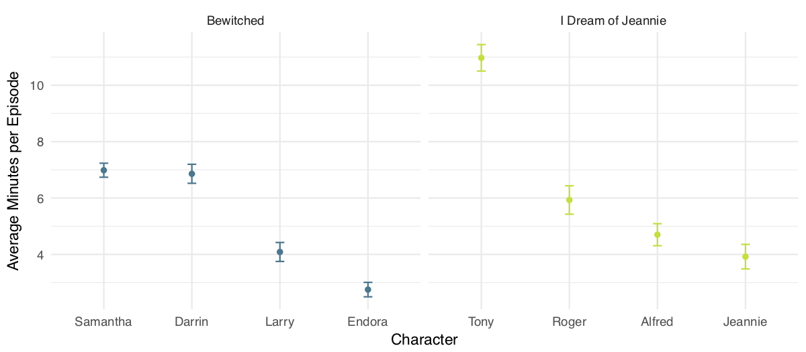
RQ1: How Does Visual Style Signal Character Centrality?
Average minutes per episode for which a character is visible.
36 – Data Science with Images | Case Study

Slide 41
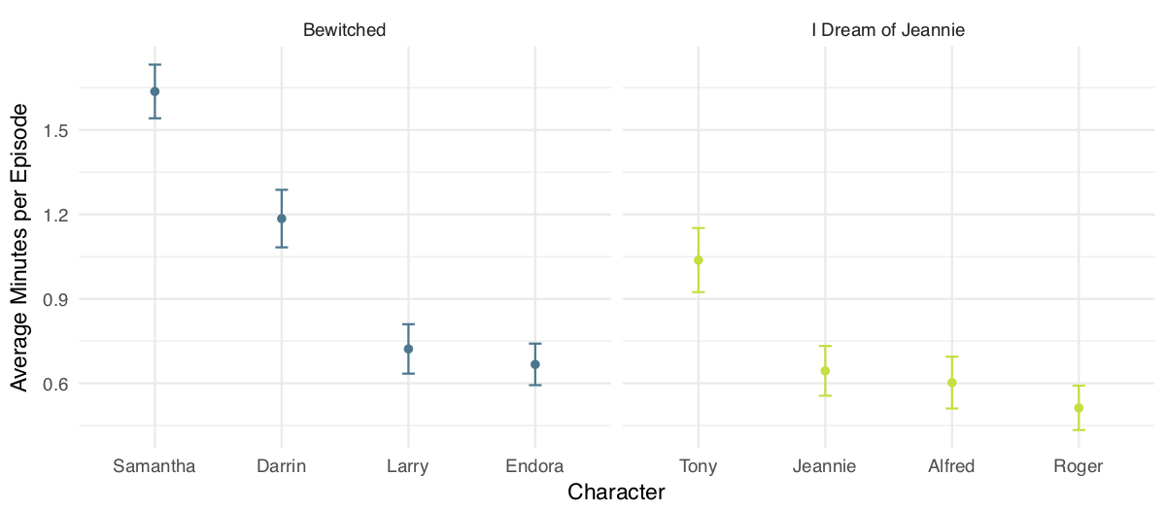
RQ1: How Does Visual Style Signal Character Centrality?
Average minutes per episode for which a character is visible in a close shot.
37 – Data Science with Images | Case Study

Slide 42
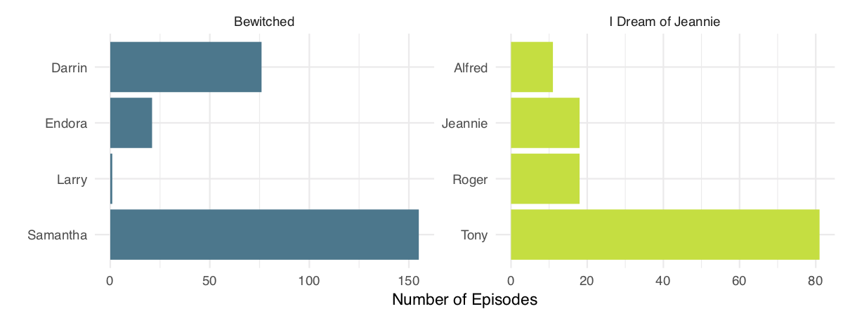
RQ1: How Does Visual Style Signal Character Centrality?
Number of episodes where each character is associated with the first face detected in an episode.
38 – Data Science with Images | Case Study

Slide 43
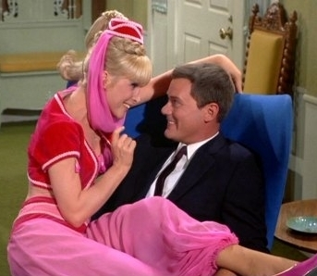
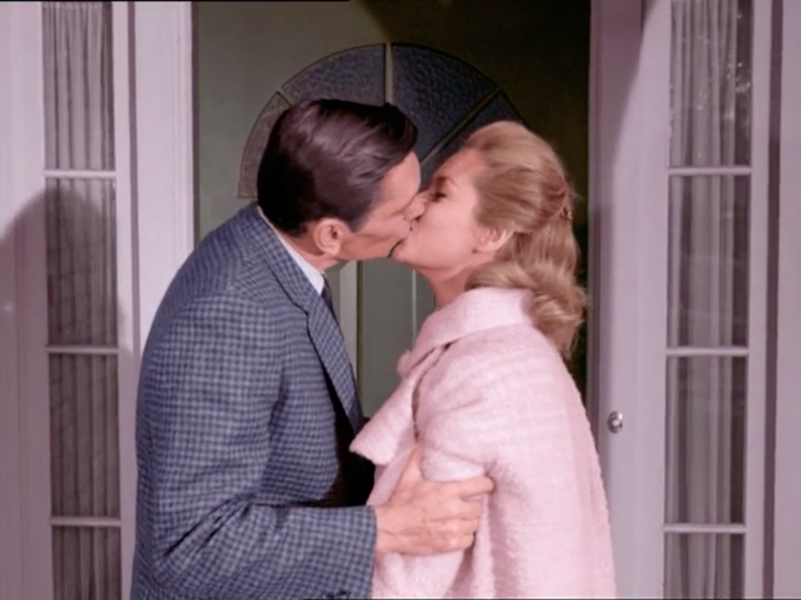
RQ2: Does visual style reinforce the connections between characters?
How do characters appearing near each other correspond to character relationships?
39 – Data Science with Images | Case Study

Slide 44
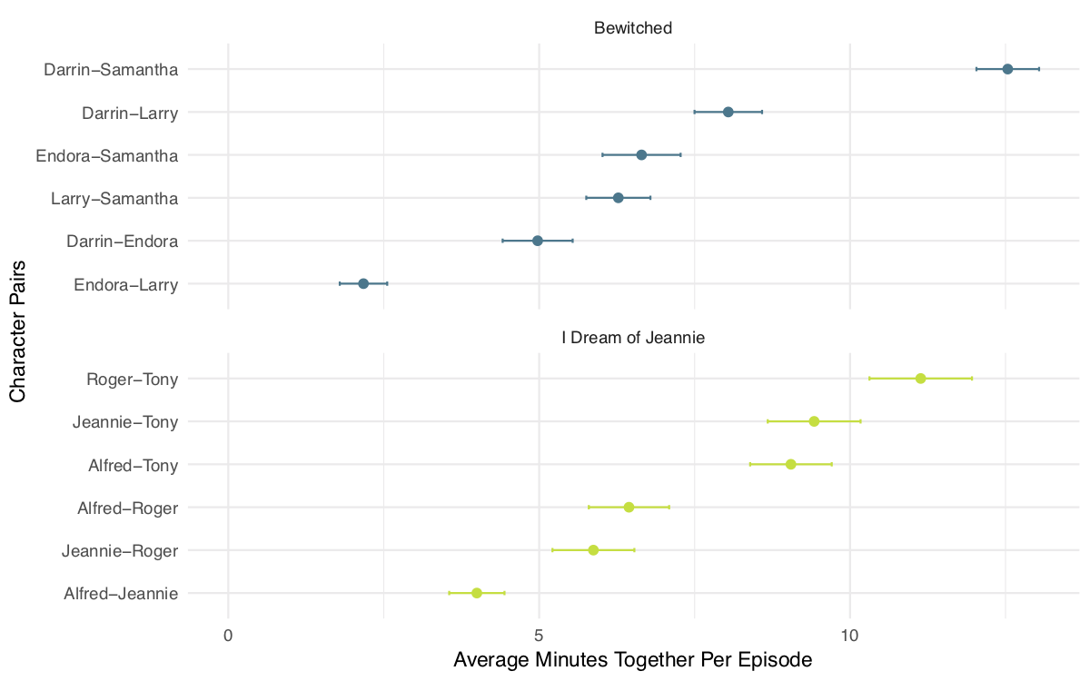
RQ2: Does visual style reinforce the connections between characters?
For each pair, how often are the characters together on screen at the same time?
40 – Data Science with Images | Case Study

Slide 45
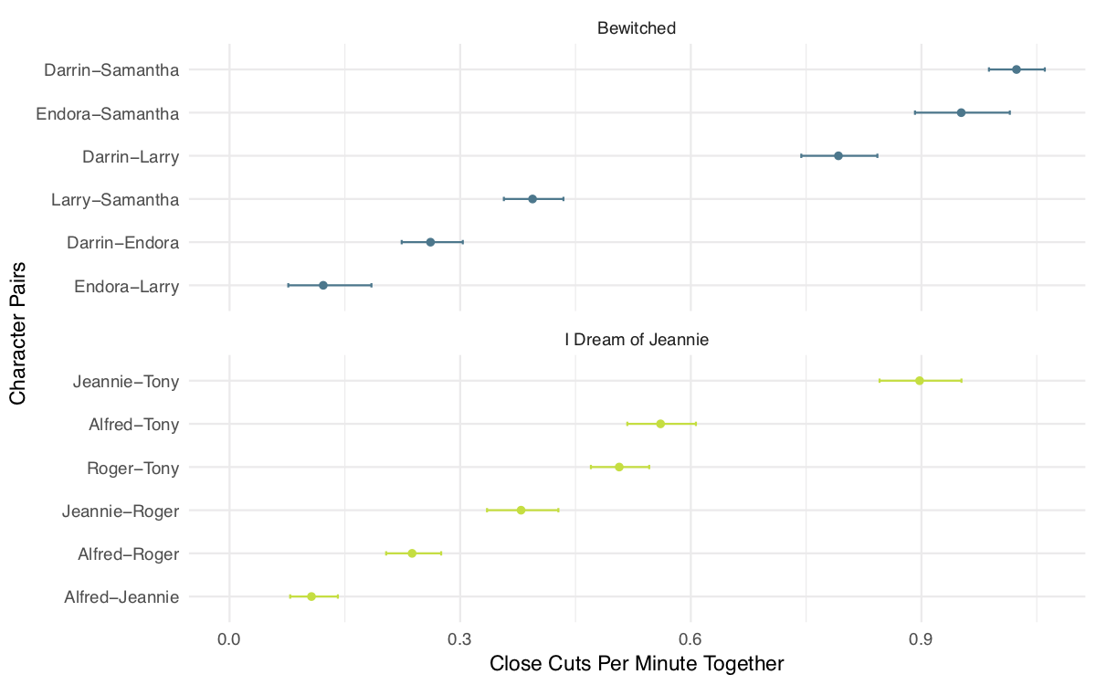
RQ2: Does visual style reinforce the connections between characters?
For each pair, how often are characters cut from one to the other?
41 – Data Science with Images | Case Study

Slide 46
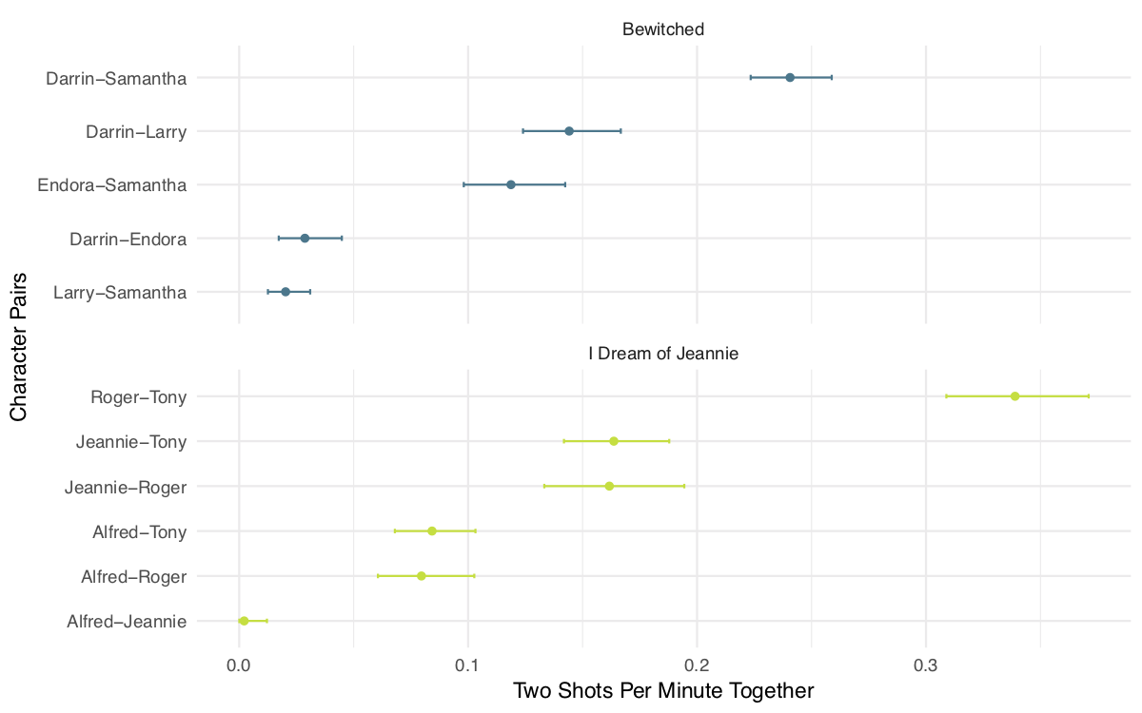
RQ2: Does visual style reinforce the connections between characters?
For each pair, how often are the characters together on screen during a two-shot?
42 – Data Science with Images | Case Study

Slide 47
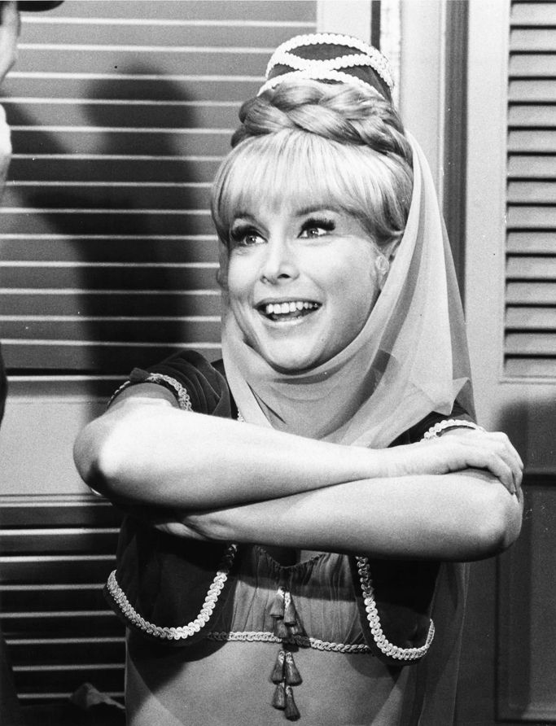
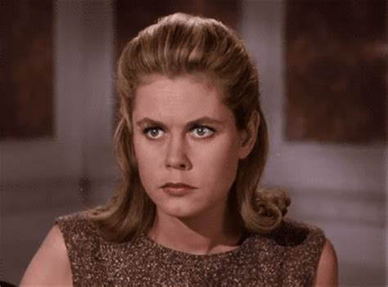
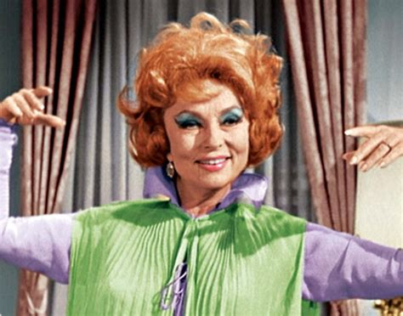
RQ3: Stylistic similarities between the feminine/magical characters?
Are their any ways the three magical women are similar?
43 – Data Science with Images | Case Study

Slide 48
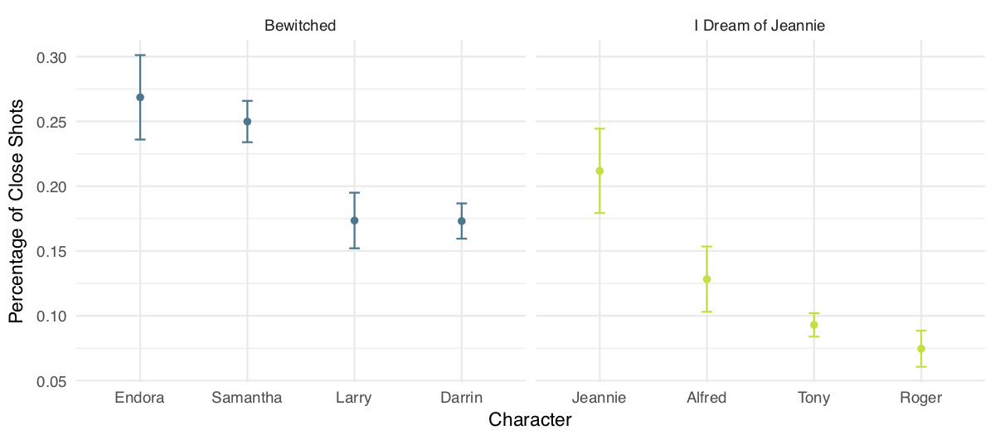
RQ3: Stylistic similarities between the feminine/magical characters?
What percentage of the time is a character shown as a close-up?
44 – Data Science with Images | Case Study

Slide 49

4
Distant Viewing Toolkit

Slide 50
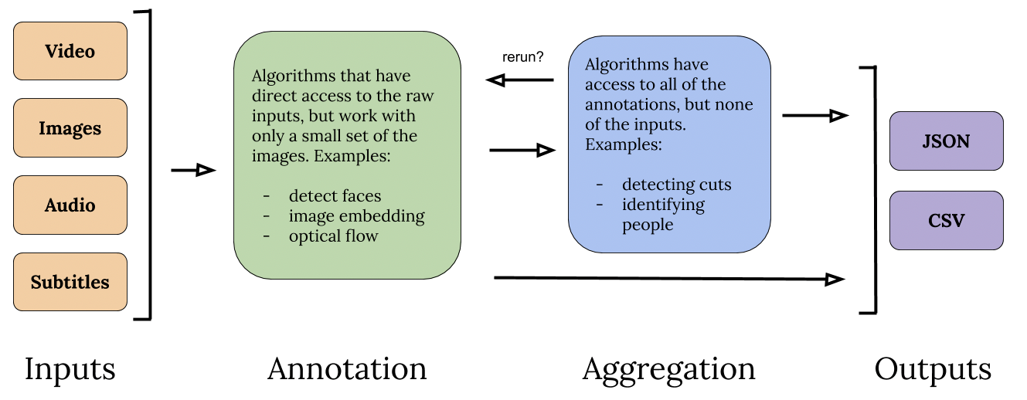
Distant Viewing Toolkit
Open-source Python library for applying common computer vision algorithms and creating structured data.
45 – Data Science with Images | DV Toolkit

Slide 51
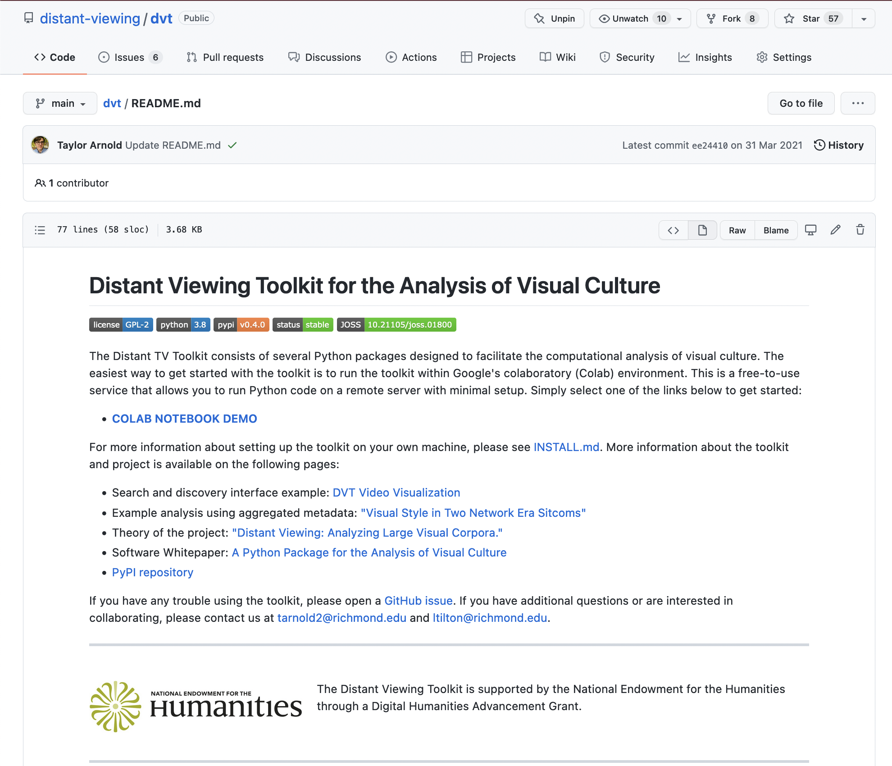
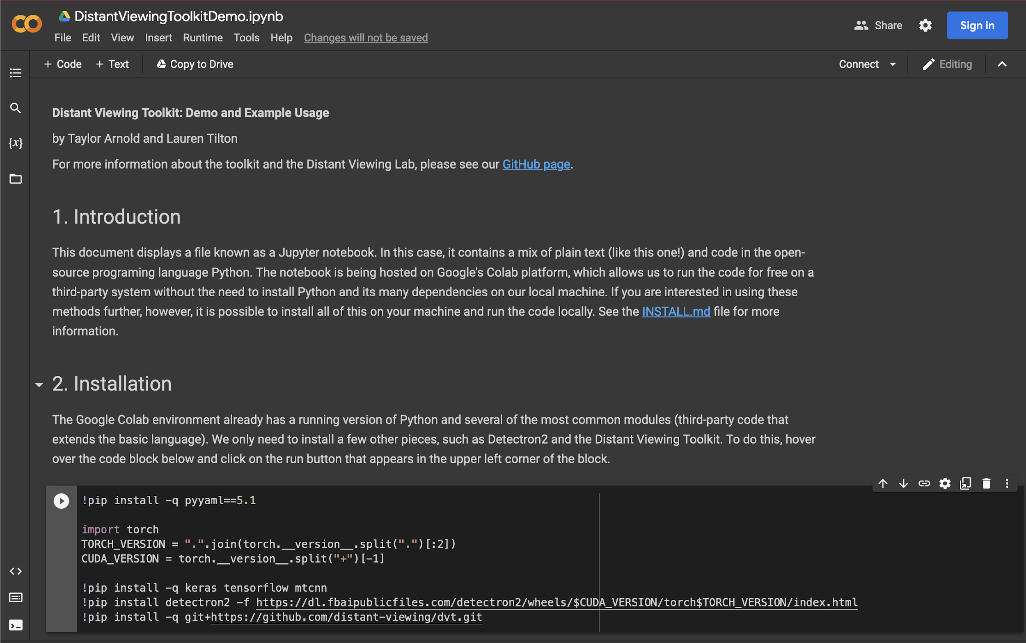
Distant Viewing Toolkit
46 – Data Science with Images | DV Toolkit

Slide 52
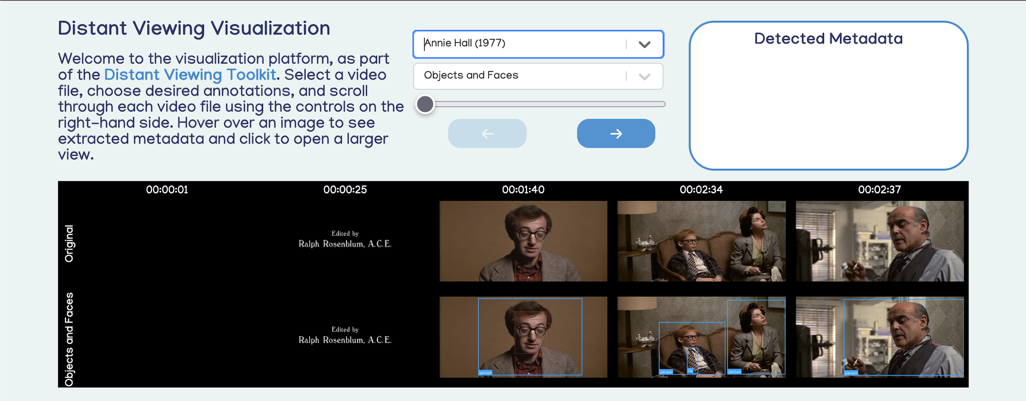
Distant Viewing Toolkit
47 – Data Science with Images | DV Toolkit

Slide 53
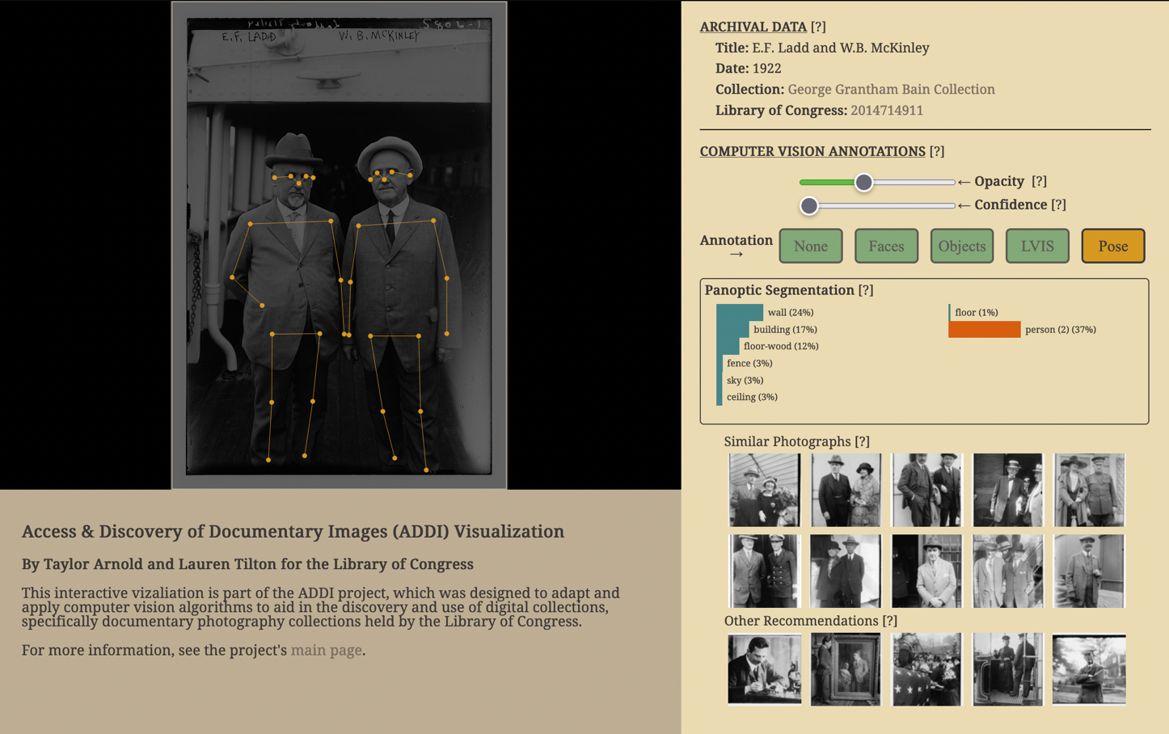
Access and Discovery of Documentary Images
48 – Data Science with Images | DV Toolkit

Slide 54
Thank You !

